Slide 1

PROJECT REPORT ON
GREENCART
Submitted by
LAWRANCE CHRISTAN A M(210021029017)
Partial fulfillment of the requirements for the award of the Degree of
BSc. Computer Science
Of
Mahatma Gandhi University
Kottayam-686560
DEPARTMENT OF COMPUTER SCIENCE
ARAFA COLLEGE OF ARTS AND SCIENCE
(Affiliated to Mahatma Gandhi University, Kottayam)
PEZHAKKAPPILLY P.O, MUVATTUPUZHA 686673
2021-2024

Slide 2
ARAFA COLLEGE OF ARTS AND SCIENCE
(Affiliated to Mahatma Gandhi University, Kottayam)
PEZHAKKAPPILLY P.O, MUVATTUPUZHA-686673
DEPARTMENT OF COMPUTER SCIENCE
CERTIFICATE
This is to certify that the project entitled “GREENCART” submitted in partial fulfillment for the award of BSC COMPUTER SCIENCE is a bonafide report of the project done by LAWRANCE CHRISTAN A M (210021029017) during the year 2021-2024.
Mrs. SACHITHRA NS
(Head of the Department)
Mrs. NISSANA PS
(Project in charge)
INTERNAL EXAMINER
EXTERNAL EXAMINER

Slide 3
DECLARATION
I here by declare that the project report entitled "GREENCART" submitted by me to Arafa College of Arts & Science, Pezhakkappilly P.O, Muvattupuzha, in partial fulfillment of the requirement for the award of the degree of BSC COMPUTER SCIENCE in Department of Computer Science is a record of bonfide project work carried out by me under the guidance of Mrs. Nissana PS. I further declare that the work reported in this project has not been submitted and will not be submitted, either in part or in full, for the award of any other degree or diploma in this institute or any other institute or university.
Place: Pezhakkappilly
Date:
Lawrance Christan AM

Slide 4
ACKNOWLEDGMENT
Apart from the efforts of mine, the success of the project depends largely on the encouragement and guidelines of many others. I take this opportunity to express my gratitude to the people who have been instrumental in the successful completion of this project.
First and foremost, I praise the God almighty for the grace he showed on me during my studies as well as day to day life. I would like to express a deep sense of gratitude to Principal Mr. Shajahan M.S. and Head of the Department Asst.Prof. Sachithra NS for their cordial support as they gave the permission to use all required equipment and the necessary material to complete the project.
I would like to extend my sincerest gratitude to Mrs. Nissana PS for her guidance and supervision as well as for providing necessary information regarding the project and also for the support in completing the project.
Finally, I also extend my heartiest thanks to my parents, friends and well-wishers for being with me and extending encouragement throughout the project.

Slide 5
TABLE OF CONTENTS
INTRODUCTION........................................................................................................1-4
SYSTEM ANALYSIS ..................................................................................................5-7
EXISTING SYSTEM...............................................................................................6
LIMITATIONS OF THE EXISTING SYSTEM ..............................................6
PROPOSED SYSTEM................................................................................................ 7
ADVANTAGES OF THE PROPOSED SYSTEM.............................................. 7
FEASIBILITY ANALYSIS.......................................................................................8-10
ECONOMIC FEASIBILITY ...................................................................................... 9
TECHNICAL FEASIBILITY ................................................................................... 10
OPERATIONAL FEASIBILITY.............................................................................. 10
SYSTEM REQUIREMENT SPECFICATION ....................................................11-16
HARDWARE CONFIGURATION .......................................................................... 12
SOFTWARE CONFIGURATION ........................................................................... 12
LANGUAGE AND TOOLS USED.....................................................................13-16
ABOUT THE FRONT END .........................................................................13-14
ABOUT THE BACK END ...........................................................................14-16
ABOUT THE OPERATING SYSTEM ............................................................. 16
SYSTEM DESIGN...................................................................................................17-32
INPUT DESIGN ..................................................................................................18
OUTPUT DESIGN ..............................................................................................19
DATABASE DESIGN .........................................................................................19
NORMALIZATION........................................................................................... 20
TABLE DESIGN AND STRUCTURE ........................................................21-26
DATAFLOW DIAGRAM ...................................................................................27-32
CODING ...................................................................................................................33-50
CODE FOR SHOP REGISTRATION .................................................................34-39
CODE FOR ADDING PLANTS..........................................................................40-50
SYSTEM TESTING ................................................................................................51-54
UNIT TESTING...................................................................................................52-53
INTEGRATION TESTING ...................................................................................... 53
VALIDATION TESTING ........................................................................................ 53
USER ACCEPTANCE TESTING............................................................................ 54

Slide 6
7.5 OUTPUT TESTING ................................................................................................. 54
SYSTEM IMPLEMENTATION ............................................................................55-56
MAINTENANCE .....................................................................................................57-58
SECURITY MEASURES......................................................................................59-61
SYTEM SECURITY............................................................................................... 60
SYSTEM INTEGRITY........................................................................................... 60
PRIVACY ............................................................................................................... 60
CONFIDENTIALITY ............................................................................................. 61
SCOPE & FUTURE ENHANCEMENTS .......................................................63
FUTURE SCOPE .................................................................................................. 63
SCOPE FOR FUTURE ENHANCEMENTS........................................................ 63
CONCLUSION ..................................................................................................64-65
REFERENCES...................................................................................................66-67
APPENDIX .........................................................................................................68-76
SCREENSHOTS ............................................................................................69-76

Slide 7
INTRODUCTION
GREENCART
- 1 -

Slide 8
GREENCART
- 2 -
1.INTRODUCTION
“GREENCART” is aimed at developing an e commerce website which coordinate and unify sales of plants. The aim of the proposed system is to simplify the process of buying and selling various plant products. This is an internet based system that can be accessed from anywhere. The existing system for plant sales comprises of thousands of shops which are non cooperative and scattered throughout, with many of them facing lack of sales despite having quality products on offer. The proposed system unifies all of the shops under one web based application.
PURPOSE
The purpose of “GREENCART” is to let shops across the state to be registered under one website. Which allows users to choose from a wide number of shops providing required product with satisfactory prices. This system also ensure consistent profit for all registered shops since users are quickly redirected towards the shop providing the product user has chosen.
MODULES
The system has four modules: -
Admin
Shop
User
Guest

Slide 9
GREENCART
- 3 -
ADMIN
“ GREENCART ” is managed by admin. It is the job of admin to let shops to register as well as users. Admin perform verification function also. Admin can perform following functions.
Add a new district or Delete an existing district.
Add a new city or Delete an existing city.
Add a new plant category or Delete an existing plant category.
Add a new complaint type or Delete an existing complaint type.
Verify shops
Generate report
Manage feedbacks.
Manage complaints.
Manage profile.
SHOP
Shops register themselves to the “ GREENCART ” they specify available plants, their details , pricing and other stock details. They perform following functions
Add plants and manage plant price and stock.
Upload plant gallery photos.
Manage orders.
Manage user complaints.
Manage profile.
Send feedbacks.
Send complaints.

Slide 10
GREENCART
- 4 -
USER
Users of “ GREENCART ” are the registered users of the application. It is strictly required for users to register in order to avail maximum benefits of the features provided by “ GREENCART ” . They perform following functions
View plants.
Purchase plants.
View orders
Cancel orders
Review the product
Download order bill
Manage profile
Send complaints
Send feedbacks
GUEST
The guest in the “GREENCART” can perform the following functions: -
View the homepage of the website.
Login
Register as a user or shop.

Slide 11
SYSTEM ANALYSIS
GREENCART
- 5 -

Slide 12
GREENCART
- 6 -
2. SYSTEM ANALYSIS
System analysis is a step-by-step process used to identify and develop or acquire the software need to control the processing of specific application. System analysis is a continuing activity of stages of the systems development. System analysis is the process of gathering and interpreting facts, diagnosing problems and using the facts to improve the system. The outputs from the organization are traced through the various processing that the input phases through in the organization. This involves gathering information and using structured tools for analysis. A detailed study of this process must be made by various techniques like interviews, questionnaires, etc.
System Development Life Cycle is a process in which system analyst, software engineers and programmers built the system. System analysis is simply finding out what happen in the existing system deciding what changes are to be made when new features are added.
It is necessary to have such a good system analysis and then by a project development cycle so that the project can be completed in a strictly manner and able to finish with the desired time. The analyst must be so careful about his responsibilities.
As the next step the current system analysis is done which identifies the real need of
establishing our project in the environment, its opportunities and constraints, etc… All of the steps discussed above are collectively known as the system analysis.
EXISTING SYSTEM
Today online shopping regarding plants only, is an unorganized and difficult process. Require long time searching over individual websites, that too only the top most recommended ones during a quick web search. And those shops and their websites having most cyber presence. This system fails to tap into the potential of unification of these shops and their web profiles.
LIMITATIONS OF THE EXISTING SYSTEM
Difficult process
Time consuming
Few results and products.
Doubtful quality
Unorganized sector overall

Slide 13
GREENCART
- 7 -
PROPOSED SYSTEM
The primary objective of the proposed system design is to overcome the drawbacks of the existing system. The proposed “GREENCART” is developed in order to unify all the individual shops, within one website which makes searching for a product much more easy and more effective. “GREENCART” contains all the info about all the registered shops and their products inventory which makes it a one stop destination for all purchases regarding plants. Users can search for a particular plant or plant type in “GREENCART” and all the shops including the nearest ones which provide the product are listed as the search result. From which the user can narrow down to the shop which he/she want to make a deal with, considering factors like lowest price, quality and others. This one website allows the users to get a uniform search result for the products across a wide area. From local places to, between districts. Users Can order plants from any district with this.
ADVANTAGES OF THE PROPOSED SYSTEM
Wide range of product to choose from.
Lowest price.
Quality products.
User friendly.
Simplified process.

Slide 14
FEASIBILITY ANALYSIS
GREENCART
- 8 -

Slide 15
GREENCART
- 9 -
3. FEASIBILITY ANALYSIS
Feasibility studies are almost always conducted where large sums are at stake. It is also called feasibility analysis Feasibility analysis is designed to determine whether or not, in the given project environment, a project will be successful. A feasibility analysis may be conducted for a project with an emphasis on financial viability, environmental integrity, cultural acceptability, or political practicability. This analysis is performed to choose the system that meets the performance requirements at least cost. The most essential tasks performed by a feasibility analysis are the identification and description of candidate systems, the evaluation of candidate systems, and the selection of the best candidate systems. The best system means the system that meets performance requirements at least cost.
Three key combinations are involved in the feasibility study and they are: -
Technical feasibility
Economic feasibility
Operational feasibility
3.1 ECONOMIC FEASIBILITY
Economic analysis is most frequently used for the evaluation of the effectiveness of the system. More commonly known as cost/benefit analysis the procedure is to determine the benefit and saving that are expected from a system and compare them with costs, decisions is made to design and implement the system.
This part of the feasibility study gives the top management the economic justification
for the new system. This is an important input to the management because very often the top management does not like to get confounded by the various technicalities that bound to be associated with a project of this kind. A simple economic analysis that gives the actual comparison of costs and benefits is much more meaningful in such cases. It is economically feasible since it requires only a single person to operate the whole system thus reducing the cost to operate the system.
In the system, the organization is most satisfied by economic feasibility. Because if
the organization implements this system, it need not require any additional hardware resources as well as it will be saving a lot of time.

Slide 16
GREENCART
- 10 -
3.2 TECHNICAL FEASIBILITY
Technical feasibility centers on the existing manual system of the test management process and to what extent it can support the system. According to the feasibility analysis procedure, the technical feasibility of the system is analyzed and the technical requirements such as software facilities, procedure, and inputs are identified. It is also one of the important phases of the system development activities. It is technically feasible since the whole system is designed with the latest technologies like PHP and SQL Server which are the most recent technologies to develop web-based systems and design databases.
The system offers greater levels of user-friendliness combined with greater processing speed. Therefore, the cost of maintenance can be reduced. Since, the processing speed is very high and the work is reduced in the maintenance point of view management convince that the project is operationally feasible.
3.3 OPERATIONAL FEASIBILITY
It is operational feasible, since the system is providing an attractive user interface to the operator/end-user, so he feels very easy to work on it. Response to operator/end-user is very fast and very good. Since, as we mentioned above that it requires much less amount of cost, it uses computer work, so it is very fast to operate and it is very easy for user to work on it.

Slide 17
SYSTEM REQUIREMENT SPECIFICATION
GREENCART
- 11 -

Slide 18
GREENCART
- 12 -
4. SYSTEM REQUIREMENT SPECIFICATION
HARDWARE CONFIGURATION
Selection of hardware configuration is very important task related to the software development. The processor should be powerful to handle all the operations. The hard disk should have the sufficient capacity to solve the database and the application.
Minimum hardware requirements:-
Processor : i3 5th Gen 2.0 GHz
Memory : 4 GB
Hard Disk : 512 GB SSD
Keyboard : Standard Keyboard
Mouse : Optical Mouse
Monitor : 14 inch Color Monitor
Graphics Card : Not needed
SOFTWARE CONFIGURATION
Front end : HTML 5, CSS 3, JavaScript
Back end : PHP 8.1.10
Database : MySQL
IDE : Visual Studio Code
Server : XAMPP, Apache
Operating System : Windows, Linux, Mac

Slide 19
GREENCART
- 13 -
LANGUAGE AND TOOLS USED
ABOUT THE FRONT END
The system is created using HTML, CSS and JavaScript as front end.
HTML
HTML is a computer language devised to allow Website creation. These Websites can then be viewed by anyone else connected to the Internet. It is relatively easy to learn, with the basics being accessible to most people in one sitting; and
quite powerful in what it allows you to create. It is constantly undergoing revision and evolution to meet the demands and requirements of the growing Internet audience under the direction of the W3C, the organization charged with designing and maintaining the language.
HTML consists of a series of short codes typed into a text-file by the site author
— these are the tags. The text is then saved as a html file, and viewed througha browser, like Internet Explorer or Netscape Navigator. This browser reads the file and translates the text into a visible form, hopefully rendering the page as the author had intended. Writing your own HTML entails using tags correctly to create your vision. You can use anything from a rudimentary text-editor to a powerful graphical editor to create HTML pages.
CSS
Stands for “Cascading Style Sheet". Cascading style sheets are used to format the
layout of Web pages. They can be used to define text styles, table sizes, and other aspects of Web pages that previously could only be defined in a page's HTML.
CSS helps Web developers create a uniform look across several pages of a Web site. Instead of defining the style of each table and each block of text within a page's HTML, commonly used styles need to be defined only once in a CSS document. Once the style is defined in cascading style sheet, it can be used by any page that references the CSS file. Plus, CSS makes it easy to change styles across several pages at once. For example, a Web developer may want to increase the default text size from 10pt to 12pt for fifty pages of a

Slide 20
GREENCART - 14 -
website. If the pages all reference the same style sheet, the text size only needs to be changed on the style sheet and all the pages will show the larger text.
While CSS is great for creating text styles, it is helpful for formatting other aspects of
Web page layout as well. For example, CSS can be used to define the cell padding of table cells, the style, thickness, and color of a table's border, and the padding around images or other objects. CSS gives Web developers more exact control over how Web pages will look than HTML does. This is why most Web pages today incorporate cascading style sheets.
JavaScript
JavaScript is a dynamic computer programming language. It is lightweight and most
commonly used as a part of Web pages, whose implementations allow client- side script to interact with the user and make dynamic pages. It is an interpreted programming language with object-oriented capabilities.
JavaScript was first known as Live Script, but Netscape changed its name to
JavaScript, possibly because of the excitement being generated by Java. JavaScript made its first appearance in Netscape 2.0 in 1995 with the name Live Script. The general-purpose core of the language has been embedded in Netscape, Internet Explorer, and other Web browsers.
4.3.2 ABOUT THE BACK END
The system is created with PHP as backend.
PHP
PHP started out as a small open source project that evolved as more and more people
found out how useful it was. Rasmus Lerdorf unleashed the first version of PHP way back in 1994.
PHP is a must for students and working professionals to become a great Software Engineer specially when they are working in Web Development Domain. The key advantages of learning PHP are: PHP is a recursive acronym for "PHP: Hypertext Preprocessor".
PHP is a server side scripting language that is embedded in HTML. It is used to manage dynamic content, databases, session tracking, even build entire e-commerce sites.It is integrated with a number of popular databases, including MySQL, PostgreSQL, Oracle, Sybase, Informix, and Microsoft SQL Server.

Slide 21
GREENCART - 15 -
PHP is pleasingly zippy in its execution, especially when compiled as an Apache module on the Unix side. The MySQL server, once started, executes even very complex queries with huge result sets in record-setting time. PHP supports a large number of major protocols such as POP3, IMAP, and LDAP.
XAMPP
XAMPP is one of the widely used cross-platform web servers, which helps developers to create and test their programs on a local webserver. It was developed by the Apache Friends, and its native source code can be revised or modified by the audience. It consists of Apache HTTP Server, MariaDB, and interpreter for the different programming languages like PHP and Perl. It is available in 11 languages and supported by different platforms such as the IA-32 package of Windows & x64 package of macOS and Linux.
XAMPP is an abbreviation where X stands for Cross-Platform, A stands for Apache, M stands for MYSQL, and the Ps stand for PHP and Perl, respectively. It is an open-source package of web solutions that includes Apache distribution for many servers and command- line executables along with modules such as Apache server, MariaDB, PHP, and Perl.
XAMPP helps a local host or server to test its website and clients via computers and laptops before releasing it to the main server. It is a platform that furnishes a suitable environment to test and verify the working of projects based on Apache, Perl, MySQL database, and PHP through the system of the host itself. Among these technologies, Perl is a programming language used for web development, PHP is a backend scripting language, and MariaDB is the most vividly used database developed by MySQL.
MySQL
MySQL is a relational database management system based on the Structured Query
Language, which is the popular language for accessing and managing the records in the database. MySQL is open-source and free software under the GNU license. It is supported by Oracle Company.
MySQL is currently the most popular database management system software used for
managing the relational database. It is open-source database software, which is supported by Oracle Company. It is fast, scalable, and easy to use database management system in comparison with Microsoft SQL Server and Oracle Database. It is commonly used in conjunction with PHP scripts for creating powerful and dynamic server-side or web-based

Slide 22
GREENCART - 16 -
enterprise applications.Many small and big companies use MySQL. MySQL supports many Operating Systems like Windows, Linux, MacOS, etc. with C, C++, and Java languages.
MySQL is a Relational Database Management System (RDBMS) software that provides many things, which are as follows:
It allows us to implement database operations on tables, rows, columns, and indexes.
It defines the database relationship in the form of tables (collection of rows and columns), also known as relations.
It provides the Referential Integrity between rows or columns of various tables.
It allows us to updates the table indexes automatically.
It uses many SQL queries and combines useful information from multiple tables for the end-users.
4.3.3 ABOUT THE OS
The OS used is Windows Operating System. We can also develop it in Linux and Mac OS also.
Windows OS
Windows is a graphical operating system developed by Microsoft. It allows users to view and store files, run the software, play games, watch videos, and provides a way to connect to the internet. It was released for both home computing and professional works.
It was released for both home computing and professional functions of Windows
on 10 November 1983. Later, it was released on many versions of Windows as well as the current version, Windows 11.
Microsoft introduced the first version as 1.0. In 1993, the first business-oriented version of Windows was released, which is known as Windows NT 3.1. Then it introduced the next versions, Windows 3.5, 4/0, and Windows 2000. When the XP Windows was released by Microsoft in 2001, the company designed its various versions for a personal and business environment. It was designed based on standard x86 hardware, like Intel and AMD processor. Accordingly, it can run on different brands of hardware, such as HP, Dell, and Sony computers, including home-built PCs.
PHP requires at least Windows 2008/Vista. Either 32-Bit or 64-bit (AKA X86 or X64.
PHP does not run on Windows RT/WOA/ARM). As of PHP 7.2.0 Windows 2008 and Vista are no longer supported.

Slide 23
SYSTEM DESIGN
GREENCART
- 17 -

Slide 24
GREENCART
- 18 -
5. SYSTEM DESIGN
The system design develops the architectural detail required to build a system or product. As in the case of any systematic approach, this software too has undergone the best possible design phase fine tuning all efficiency, performance and accuracy levels. The first step in system designing is to determine how the output is to be produced and in what format. Samples of the output and input are also presented. In the second step, input data and master files are to be designed to meet requirements of the proposed output. The processing phases are handled through program construction and testing, including a list of the programs needed to meet the system’s objectives and complete documentation.
INPUT DESIGN
Input design is a part of overall system design, which requires very careful attention. Generally, software is prone to error if the user operating on it is not aware of constraints. A usual procedure for eliminating errors is carried out in the application program itself. However, there are cases where the
data redundancy and consistency are violated. The goal of designing input data entry as easy, logical and free from errors as possible. In entering data, operators need to know the following :-
The allocated space for each field.
Field sequence, which must match that in the source document.
The format in which data fields are entered.
When we approach input data design, we design the source documents that capture the data and then select the media used to enter them into computer or the system. While entering the data the application program checks for errors. All the input screens used have strict validation for null checking and the data type wherever necessary

Slide 25
GREENCART
- 19 -
5.2 OUTPUT DESIGN
Output is the most important direct source of information to the user and to the management. Efficient and eligible output design should improve the system's relationship with the user and help in decision-making.
Output design generally deals with the results generated by the system i.e., reports. These reports can be generated from stored or calculated values. Reports are displayed either as screen window preview or printed form. Most end users will not actually operate the information system or enter data through a workstation, but they will use the output from the system.
Output from the computer system is required primarily to communicate the results of
processing of the user. They are also used to provide a permanent copy of these results for later consultation.
5.3 DATABASE DESIGN
A database is a repository of information. It is a collection of interrelate data stored with minimum redundancy to serve many user quick and efficiently. The general objective us take information access easy, quick, inexpensive and flexible for the users. In this project, we are mainly concentrated into relational databases. Relational databases stores data in tables, with in turn, are composed of rows also known as fields.
The overall objective in the development of database technology has been to treat data
as an organizational resource and as an integrated whole. DBMS allow data to be protected and organized separately from other resources. Database is an integrated collection of data. The most significant form of data as seen by the programmers is data as stored on the direct access storage devices. This is the difference between logical and physical data.
Database files are the key source of information into the system. It is the process of designing database files, which are the key source of information to the system. The files should be properly designed and planned for collection, accumulation, editing and retrieving the required information.

Slide 26
GREENCART
- 20 -
The organization of data in database aims to achieve three major objectives: -
Data integration.
Data integrity.
Data independence.
The proposed system stores the information relevant for processing in the MySQL SERVER database. This database contains tables, where each table corresponds to one particular type of information. Each piece of information in table is called a field or column. A table also contains records, which is a set of fields. All records in a table have the same set of fields with different information. There are primary key fields that uniquely identify a record in a table. There are also fields that contain primary key from another table called foreign keys.
NORMALIZATION
Normalization is a technique of separating redundant fields and braking up a large table in to a smaller one. It is also used to avoid insertion, deletion and updating anomalies. All the tables have been normalized up to the third normal form. In short, the rules for each of the three normal forms are as below.
First normal form
A relation is said to be in 1NF if all the under lying domain of attributes contain simple individual values.
Second normal form
The 2NF is based on the concept of full functional dependency. A relation said to be in 2NF
if and only if it is in 1NF and every non-key attribute is fully functionally dependent on candidate key of the table.
Third normal form
The 3NF is based on the concept of transitive dependency. A relation in 2NF is said to be in 3NF if every non-key attribute is non-transitively.

Slide 27
GREENCART
- 21 -
5.3.2 TABLE DESIGN AND STRUCTURE
The general theme behind the database is to handle information as an integrated whole. A database is a collection of interrelated data stored with minimum redundancy to serve many quickly and effectively. The database is a collection of stored data organized in such a way that all the data requirements are satisfied by the database.
The aim of database design is to improve the existing system situation. A number of database files were designed to hold the data requirements for running their systems.
1. TABLE NAME: tbl_admin
TABLE DESCRIPTION: Table for admin
FIELD NAME | DATATYPE | SIZE | CONSTRAINTS | FIELD DESCRIPTION
admin_id | int | 11 | Primary Key | Admin ID
admin_name | varchar | 100 | Not null | Admin’s name
admin_email | varchar | 100 | Not null | Admin’s email
admin_password | varchar | 100 | Not null | Admin’s password
2. TABLE NAME: tbl_shop
TABLE DESCRIPTION: Table for shop
FIELD NAME | DATATYPE | SIZE | CONSTRAINTS | FIELD DESCRIPTION
shop_id | Int | 11 | Primary key | Shop ID
shop_name | varchar | 100 | Not null | Shop’s name
shop_address | varchar | 100 | Not null | Shop’s address
shop_pincode | Varchar | 100 | Not null | Shop’s pin code
city_id | int | 11 | Foreign key | Represent city
shop_photo | varchar | 100 | Not null | Shop’s photo
shop_proof | varchar | 100 | Not null | Shop’s proof
shop_email | varchar | 100 | Not null | Shop’s email
shop_contactno | varchar | 100 | Not null | Shop’s contact number
shop_password | varchar | 100 | Not null | Shop’s password
shop_status | tinyint | 1 | Not null | Shop’s status
shop_doj | date |  | Not null | Shop’s date of join

Slide 28
GREENCART
- 22 -
3. TABLE NAME: tbl_user
TABLE DESCRIPTION: Table for user
FIELD NAME | DATATYPE | SIZE | CONSTRAINTS | FIELD DESCRIPTION
user_id | int | 11 | Primary key | User ID
user_name | varchar | 100 | Not null | User’s name
user_gender | varchar | 10 | Not null | User’s gender
user_dob | date |  | Not null | User’s date of birth
user_address | varchar | 500 | Not null | User’s address
user_pincode | int | 11 | Not null | User’s pin code
user_photo | varchar | 500 | Not null | User’s photo
user_contactno | varchar | 30 | Not null | User’s contact number
user_email | varchar | 100 | Not null | User’s email
user_password | varchar | 100 | Not null | User’s password
city_id | int | 11 | Foreign key | Represent city
4. TABLE NAME: tbl_city
TABLE DESCRIPTION: Table for city
FIELD NAME | DATATYPE | SIZE | CONSTRAINTS | FIELD DESCRIPTION
city_id | int | 11 | Primary key | City ID
city_name | varchar | 100 | Not null | City’ name
city_del_status | tinyint | 1 | Not null | City delete status
district_id | int | 11 | Foreign key | Represent district
5. TABLE NAME: tbl_district
TABLE DESCRIPTION: Table for district
FIELD NAME | DATATYPE | SIZE | CONSTRAINTS | FIELD DESCRIPTION
district_id | int | 11 | Primary key | District ID
district_name | varchar | 100 | Not null | District’s name
district_del_status | tinyint | 4 | Not null | District delete status

Slide 29
GREENCART
- 23 -
6. TABLE NAME: tbl_plant
TABLE DESCRIPTION: Table for plant
FIELD NAME | DATATYPE | SIZE | CONSTRAINTS | FIELD DESCRIPTION
plant_id | int | 11 | Primary key | Plant ID
plant_name | varchar | 100 | Not null | Plant’s name
plant_description | varchar | 900 | Not null | Plant’s description
plant_photo | varchar | 100 | Not null | Plant’s photo
plant_price | double |  | Not null | Plant’s price
plant_stock | int | 11 | Not null | Plant’s stock
plant_rating | double |  | Not null | Plant’s rating
plant_del_status | tinyint | 1 | Not null | Plant delete status
plant_category_id | int | 11 | Foreign key | Represent plant category
shop_id | int | 11 | Foreign key | Represent shop
7. TABLE NAME: tbl_plant_category
TABLE DESCRIPTION: Table for plant category
FIELD NAME | DATA TYPE | SIZE | CONSTRAINTS | FIELD DESCRIPTION
plant_category_id | int | 11 | Primary key | Plant category ID
plant_category_name | varchar | 100 | Not null | Plant’s category name
Plant_category_del_status | varchar | 900 | Not null | Plant category delete status
8. TABLE NAME: tbl_plant_gallery
TABLE DESCRIPTION: Table for plant gallery
FIELD NAME | DATA TYPE | SIZE | CONSTRAINTS | FIELD DESCRIPTION
plant_gallery_id | int | 11 | Primary key | Plant gallery ID
plant_gallery_photo | varchar | 100 | Not null | Plant’s gallery photo
plant_gallery_del_status | tinyint | 4 | Not null | Plant gallery delete status
plant_id | int | 11 | Foreign key | Represent plant

Slide 30
GREENCART
- 24 -
9. TABLE NAME: tbl_plant_rating
TABLE DESCRIPTION: Table for plant rating
FIELD NAME | DATA TYPE | SIZE | CONSTRAINTS | FIELD DESCRIPTION
plant_rating_id | int | 11 | Primary key | Plant rating ID
plant_rating_user_review | varchar | 500 | Not null | Plant’s rating user review
user_id | int | 11 | Foreign key | Represent user
plant_id | int | 11 | Foreign key | Represent plant
plant_rating_star | Int | 11 | Not null | Plant rating star type
10. TABLE NAME: tbl_cart
TABLE DESCRIPTION: Table for shopping cart
FIELD NAME | DATA TYPE | SIZE | CONSTRAINTS | FIELD DESCRIPTION
cart_id | int | 11 | Primary key | Cart ID
cart_quantity | int | 11 | Not null | Cart quantity
cart_del_status | tinyint | 1 | Not null | Cart delete status
plant_id | int | 11 | Foreign key | Represent plant
user_id | Int | 11 | Foreign key | Represent user
11. TABLE NAME: tbl_order
TABLE DESCRIPTION: Table for orders
FIELD NAME | DATA TYPE | SIZE | CONSTRAINTS | FIELD DESCRIPTION
order_id | int | 11 | Primary key | Order ID
order_number | int | 11 | Not null | Order number
order_place | varchar | 100 | Not null | Order place
order_status | tinyint | 4 | Not null | Order status
order_date | date |  | Not null | Order date
cart_id | int | 11 | Foreign key | Represent cart

Slide 31
GREENCART
- 25 -
12. TABLE NAME: tbl_feedback
TABLE DESCRIPTION: Table for feedback
FIELD NAME | DATA TYPE | SIZE | CONSTRAINTS | FIELD DESCRIPTION
feedback_id | int | 11 | Primary key | Feedback ID
feedback_content | varchar | 100 | Not null | Feedback content
feedback_rating | Int | 11 | Not null | Feedback rating
feedback_time | varchar | 100 | Not null | Feedback time
feedback_status | tinyint | 4 | Not null | Feedback status
user_id | int | 11 | Foreign key | Represent user
shop_id | int | 11 | Foreign key | Represent shop
13. TABLE NAME: tbl_admin_complaint
TABLE DESCRIPTION: Table for admin complaints
FIELD NAME | DATA TYPE | SIZE | CONSTRAINTS | FIELD DESCRIPTION
admin_complaint_id | int | 11 | Primary key | Admin complaint ID
admin_complaint_content | varchar | 500 | Not null | Admin complaint content
admin_complaint_reply | varchar | 500 | Not null | Admin complaint reply
admin_complaint_time | varchar | 100 | Not null | Admin complaint time
admin_complaint_del_status | tinyint | 4 | Not null | Admin complaint delete status
complaint_type_id | int | 11 | Foreign key | Represent complaint type
user_id | int | 11 | Foreign key | Represent user
shop_id | int | 11 | Foreign key | Represent shop

Slide 32
GREENCART
- 26 -
14. TABLE NAME: tbl_shop_complaint
TABLE DESCRIPTION: Table for shop complaints
FIELD NAME | DATA TYPE | SIZE | CONSTRAINTS | FIELD DESCRIPTION
shop_complaint_id | int | 11 | Primary key | Shop complaint ID
shop_complaint_content | varchar | 500 | Not null | Shop complaint content
shop_complaint_reply | varchar | 500 | Not null | Shop complaint reply
shop_complaint_time | varchar | 100 | Not null | Shop complaint time
shop_complaint_del_status | tinyint | 4 | Not null | Shop complaint delete status
complaint_type_id | int | 11 | Foreign key | Represent complaint type
user_id | int | 11 | Foreign key | Represent user
shop_id | int | 11 | Foreign key | Represent shop
15. TABLE NAME: tbl_complaint_type
TABLE DESCRIPTION: Table for complaint types
FIELD NAME | DATA TYPE | SIZE | CONSTRAINTS | FIELD DESCRIPTION
complaint_type_id | int | 11 | Primary key | Complaint type ID
complaint_type_name | varchar | 100 | Not null | Complaint type name
complaint_type_status | tinyint | 4 | Not null | Complaint type status
complaint_type_del_status | tinyint | 4 | Not null | Complaint type delete status

Slide 33
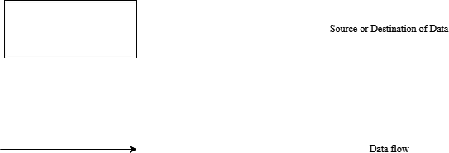
GREENCART
- 27 -
5.4 DATAFLOW DIAGRAM
To start the system design, something analogue to the architecture blueprint as a starting point to design is required. It is a way to focus on functions rather than physical implementation. One such tool is a DFD.
Structured analysis is a set of techniques and graphical tools that help the analyst to
develop a new kind of system specification that is easily understandable to the user. DFDs show the major decompositions of the system functions and their interfaces. The DFD is graphic and presents a picture of what is being specified and is conceptually easy to understand presentation of the application.
One important feature of DFDs is that it is logical rather than physical. The elements of the system do not depend on vendors or hardware. They specify in a precise, concise manner the working of the system and how it hangs together.
The process should be named and numbered for easy references.
The direction of flow is from top to bottom and from left to right
When a process is imported in the lower levels details, they must be numbered
Process and data flow names have the first letter of each word mud be a capital letter
The symbols used in DFD are shown below: -

Slide 34
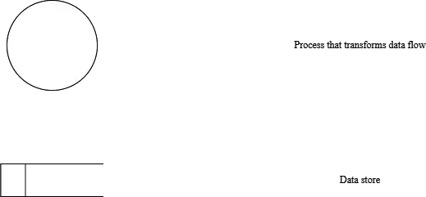
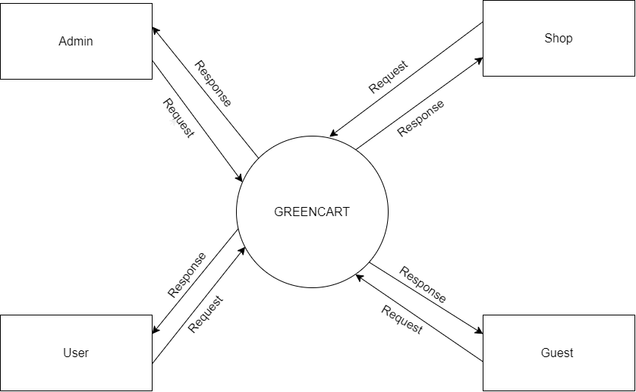
GREENCART
- 28 -
LEVEL-0

Slide 35
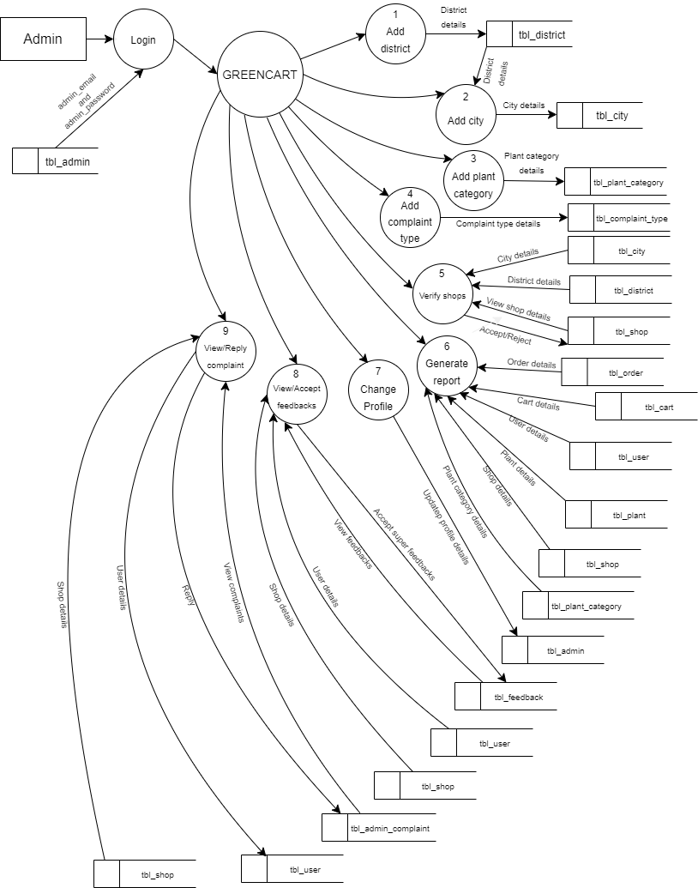
GREENCART
- 29 -
LEVEL-1 FOR ADMIN

Slide 36
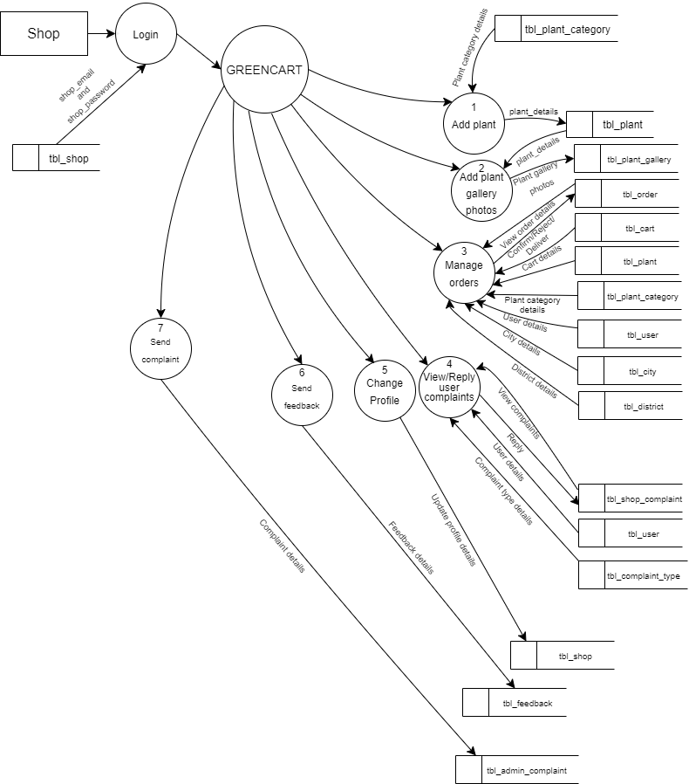
GREENCART
- 30 -
LEVEL-1 FOR SHOP

Slide 37
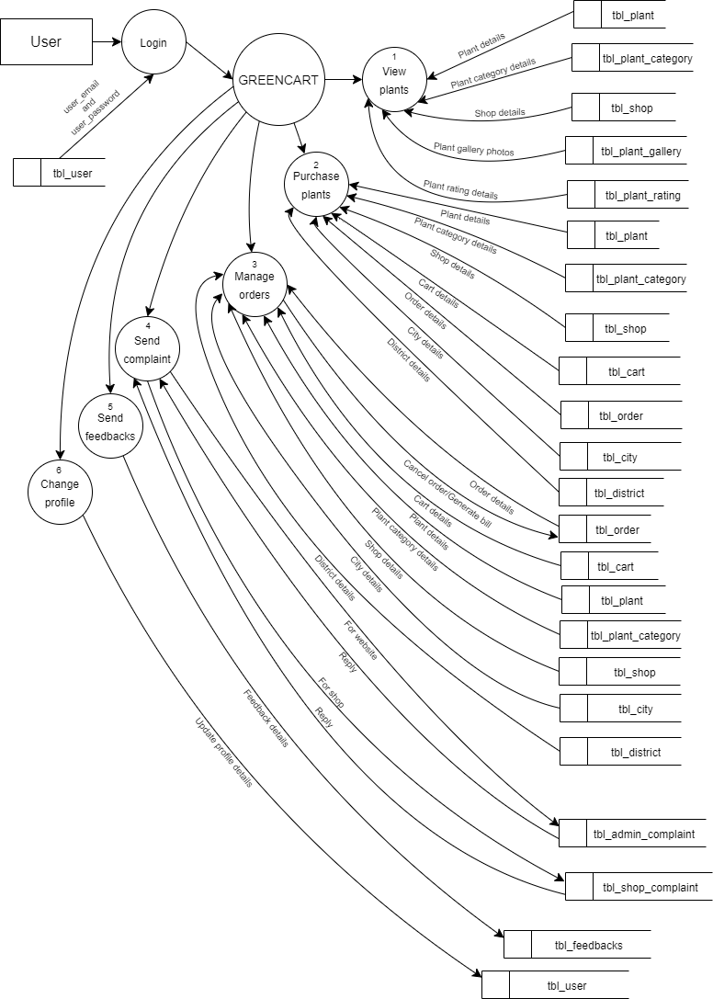
GREENCART
- 31 -
LEVEL-1 FOR USER

Slide 38
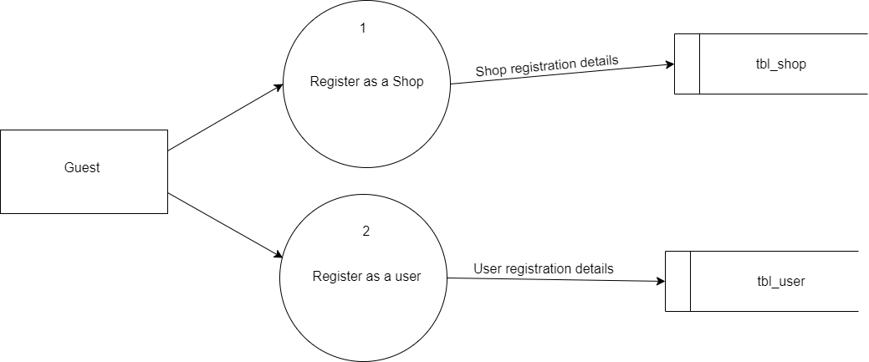
GREENCART
- 32 -
LEVEL-1 FOR GUEST

Slide 39
CODING
GREENCART
- 33 -

Slide 40
GREENCART
- 34 -
6. CODING
6.1 CODE FOR SHOP REGISTRATION
<?php
include("../Assets/Connection/connection.php");
session_start();
if (isset($_POST['btn_submit'])) {
$shop_name = $_POST['txt_shop_name'];
$shop_address = $_POST['txt_shop_address'];
$shop_city = $_POST['sel_city'];
$time = time() . date('m-d-Y');
$shop_contactno = $_POST['txt_shop_contactno'];
$shop_email = $_POST['txt_shop_email'];
$shop_password = $_POST['txt_shop_password'];
$shop_cpassword = $_POST['txt_shop_cpassword'];
$file_name_photo = $time . $_FILES['shop_photo']['name'];
$temp_file_name_photo = $_FILES['shop_photo']['tmp_name'];
$file_name_proof = $time . $_FILES['shop_proof']['name'];
$temp_file_name_proof = $_FILES['shop_proof']['tmp_name'];
$shop_doj = date('d-m-y');
$shop_pincode = $_POST['txt_shop_pincode'];
if ($shop_password != $shop_cpassword) {
?>
<script>
alert("Password does not match");
</script>
<?php
} else {
$insQuery = "insert into tbl_shop(shop_name,shop_address,city_id,shop_photo,shop_proof,shop_contactno,shop_email,shop_password,shop_doj,shop_pincode) values('$shop_name','$shop_address',$shop_city,'$file_name_photo','$file_name_proof','$shop_contactno','$shop_email','$shop_password','$shop_doj','$shop_pincode')";
$selQuery = "select * from tbl_shop where shop_email = '$shop_email'";
$result = $conn->query($selQuery);
if ($result->num_rows) {
?>
<script>
alert('Email already exists');
</script>

Slide 41
GREENCART
- 35 -
<?php
} else {
if ($conn->query($insQuery)) {
move_uploaded_file($temp_file_name_photo, '../Assets/Files/Shop/Photo/' . $file_name_photo);
move_uploaded_file($temp_file_name_proof, '../Assets/Files/Shop/Proof/' . $file_name_proof);
?>
<script>
alert('Successfully registered');
</script>
<?php
$selQuery = "select * from tbl_shop where shop_email = '$shop_email' and shop_password = '$shop_password'";
$result = $conn->query($selQuery);
$data = $result->fetch_assoc();
$_SESSION['sid'] = $data['shop_id'];
?>
<script>
window.location = '../Shop/ShopHomePage.php';
</script>
<?php
}
}
}
}
?>
<!DOCTYPE html>
<html lang="en">
<head>
<meta charset="utf-8">
<title>GREENCART - shop registration</title>
<meta content="width=device-width, initial-scale=1.0" name="viewport">
<meta content="Free HTML Templates" name="keywords">
<meta content="Free HTML Templates" name="description">
<link href="../Assets//Template//Login//assets/css/bootstrap.min.css" rel="stylesheet">
<link href="../Assets//Template//Login//assets/css/font-awesome.min.css" rel="stylesheet">
<link href="../Assets//Template//Login//assets/css/style.css" rel="stylesheet">
<link href="../Assets//Template//MainTemplate//img/favicon.ico" rel="icon">
<link rel="preconnect" href="https://fonts.gstatic.com">
<link href="https://fonts.googleapis.com/css2?family=Poppins&family=Roboto:wght@700&display=swap" rel="stylesheet">

Slide 42
GREENCART
- 36 -
<link href="https://cdn.jsdelivr.net/npm/bootstrap-icons@1.4.1/font/bootstrap-icons.css" rel="stylesheet">
<link href="../Assets//Template//MainTemplate//lib/flaticon/font/flaticon.css" rel="stylesheet">
<link href="../Assets//Template//MainTemplate//lib/owlcarousel/assets/owl.carousel.min.css" rel="stylesheet">
<link href="../Assets///Template//MainTemplate//css/bootstrap.min.css" rel="stylesheet">
<link href="../Assets///Template//MainTemplate//css/style.css" rel="stylesheet">
<link rel="stylesheet" href="../Assets//CSS//Guest//userRegistration.css">
<link rel="stylesheet" href="https://cdnjs.cloudflare.com/ajax/libs/bootstrap-datepicker/1.4.1/css/bootstrap-datepicker3.css" />
</head>
<body>
<br>
<nav class="navbar navbar-expand-lg bg-white navbar-light shadow-sm py-3 py-lg-0 px-3 px-lg-0">
<a href="index.html" class="navbar-brand ms-lg-5">
<h1 class="m-0 text-uppercase" style="color:#548302;"><i class="bi fs-1 text-primary me-3"></i>GREENCART</h1>
</a>
<button class="navbar-toggler" type="button" data-bs-toggle="collapse" data-bs-target="#navbarCollapse">
<span class="navbar-toggler-icon"></span>
</button>
<div class="collapse navbar-collapse" id="navbarCollapse">
<div class="navbar-nav ms-auto py-0">
<a href="../index.php" class="nav-item nav-link">Home</a>
<a href="./login.php" class="nav-item nav-link">Login</a>
<div class="nav-item dropdown">
<a href="#" class="nav-link active dropdown-toggle" data-bs-toggle="dropdown">Register</a>
<div class="dropdown-menu m-0">
<a href="./userRegistration.php" class="dropdown-item">User</a>
<a href="./ShopRegistration.php" class="dropdown-item">Shop</a>
</div>
</div>
<a href="contact.html" class="nav-item nav-link nav-contact text-white px-5 ms-lg-5">Contact
<i class="bi bi-arrow-right"></i></a>

Slide 43
GREENCART
- 37 -
</div>
</div>
</nav>
<section class="d-flex justify-content-center" style="background:url('../Assets//Img//login.jpg');background-repeat: no-repeat;">
<form class="form-control" style="width:85%;margin-top: 5%;margin-bottom: 5%; background:rgb(255,255,255); padding:5%;" method="post" enctype="multipart/form-data">
<p class="h3 text-center" style="color: #548302;">SHOP REGISTRATION</p>
<div class="mb-3">
<label for="">Name: </label>
<input type="text" class="form-control" placeholder="Enter shop name" name="txt_shop_name" required>
</div>
<div class="mb-3">
<label class="control-label" for="date">Address</label>
<textarea class="form-control" name="txt_shop_address" placeholder="Enter shop address" rows="5" required></textarea>
</div>
<div class="mb-3">
<label for="">Pincode: </label>
<input type="number" class="form-control" placeholder="Enter Pincode" name="txt_shop_pincode" required>
</div>
<div class="mb-3">
<label class="control-label" for="date" name="sel_district">District</label>
<select class="form-select" required name="sel_district" onChange="getCity(this.value)">
<option value="0">---Select District---</option>
<?php
$selQuery = "select * from tbl_district";
$result = $conn->query($selQuery);
while ($row = $result->fetch_assoc()) {
?>
<option value=<?php echo $row['district_id']; ?>>
<?php echo $row['district_name']; ?>
</option>
<?php
}
?>
</select>
</div>

Slide 44
GREENCART
- 38 -
<div class="mb-3" id="get_city">
</div>
<div class="mb-3">
<label for="formFile" class="form-label">Shop Photo</label>
<input type="file" class="form-control" id="formFile" name="shop_photo" required>
</div>
<div class="mb-3">
<label for="formFile" class="form-label">Shop Proof</label>
<input type="file" class="form-control" id="formFile" name="shop_proof" required>
</div>
<div class="mb-3">
<label for="">Contact number: </label>
<input type="number" class="form-control" placeholder="Enter Contact" name="txt_shop_contactno" required>
</div>
<div class="mb-3">
<label for="">Email: </label>
<input type="email" class="form-control" placeholder="Enter Email" name="txt_shop_email" required>
</div>
<div class="mb-3">
<label for="">Password: </label>
<input type="password" class="form-control" placeholder="Enter Password" name="txt_shop_password" required>
</div>
<div class="mb-3">
<label for="">Confirm Password: </label>
<input type="password" class="form-control" placeholder="Confirm Password" name="txt_shop_cpassword" required>
</div>
<center>
<button type="submit" class="btn" style="background: #548302;color:#fff;" name="btn_submit">Submit</button>
</center>
</form>
</section>
<?php include('../Assets/Template/MainTemplate/Guest/footer.php'); ?>
<!-- JavaScript Libraries -->
<script src="https://code.jquery.com/jquery-3.4.1.min.js"></script>
<script src="https://cdn.jsdelivr.net/npm/bootstrap@5.0.0/dist/js/bootstrap.bundle.min.js"></script>
<script src="../Assets//Template//MainTemplate//lib//easing/easing.min.js"></script>

Slide 45
GREENCART
- 39 -
<script src="../Assets//Template//MainTemplate//lib/waypoints/waypoints.min.js"></script>
<script src="../Assets//Template//MainTemplate//lib/owlcarousel/owl.carousel.min.js"></script>
<script src="../Assets//Template//MainTemplate//js/main.js"></script>
<script src="../Assets//JS//Guset//userRegistration.js"></script>
<!-- Include jQuery -->
<script type="text/javascript" src="https://code.jquery.com/jquery-1.11.3.min.js"></script>
<script type="text/javascript" src="https://cdnjs.cloudflare.com/ajax/libs/bootstrap-datepicker/1.4.1/js/bootstrap-datepicker.min.js"></script>
<script src="../Assets//JS//Ajax//jQuery.js"></script>
<script>
$(document).ready(function() {
var date_input = $('input[name="date"]'); //our date input has the name "date"
var container = $('.bootstrap-iso form').length > 0 ? $('.bootstrap-iso form').parent() : "body";
date_input.datepicker({
format: 'mm/dd/yyyy',
container: container,
todayHighlight: true,
autoclose: true,
})
})
</script>
<script>
function getCity(did) {
$.ajax({
url: '../Assets//AjaxPages//AjaxCity.php?did=' + did,
success: function(result) {
$("#get_city").html(result);
}
});
}
</script>
</body>
</html>

Slide 46
GREENCART
- 40 -
6.2 CODE FOR ADDING PLANTS
<?php
ob_start();
session_start();
include("../Assets/Connection/connection.php");
if (!$_SESSION['sid']) {
?>
<script>
window.location = '../index.php'
</script>
<?php
}
if (isset($_POST['btn_save'])) {
if ($data['shop_status'] == true && $data['shop_del_status'] == false) {
$plant_name = $_POST['txt_plant_name'];
$plant_category = $_POST['sel_plant_category'];
$plant_description = $_POST['txt_plant_description'];
$plant_price = $_POST['txt_plant_price'];
$time = time() . date('m-d-Y');
$file_name_photo = $time . $_FILES['file_plant_photo']['name'];
$temp_file_name_photo = $_FILES['file_plant_photo']['tmp_name'];
$insQuery = "insert into tbl_plant(plant_name,plant_category_id, plant_photo, plant_description, plant_price,shop_id) values('$plant_name',$plant_category,'$file_name_photo','$plant_description',$plant_price," . $data['shop_id'] . ")";
if ($conn->query($insQuery)) {
move_uploaded_file($temp_file_name_photo, '../Assets/Files/Plant/' . $file_name_photo);
?>
<script>
alert('Saved')
window.location = './ShopPlants.php'
</script>
<?php
}
} else if ($data['shop_status'] == true && $data['shop_del_status'] == true) {
?>
<script>
alert("This feature is not available.Because your shop's account is temporarily blocked")
window.location = './ShopPlants.php'
</script>
<?php
}

Slide 47
GREENCART
- 41 -
else {
?>
<script>
alert('This has not verified')
window.location = './ShopPlants.php'
</script>
<?php
}
}
$selQuery = "select * from tbl_plant where shop_id =" . $data['shop_id'];
$result = $conn->query($selQuery);
$count = $result->num_rows;
$i = 1;
while ($i <= $count) {
if (isset($_POST["btn_gsubmit$i"])) {
$time = time() . date('m-d-Y');
$plantId = $_POST["btn_gsubmit$i"];
$file_name = $time . $_FILES["file_plant_gallery$i"]["name"];
$tmp_file_name = $_FILES["file_plant_gallery$i"]["tmp_name"];
$insQuery = "insert into tbl_plant_gallery(plant_gallery_photo,plant_id) values('$file_name',$plantId)";
if ($conn->query($insQuery)) {
move_uploaded_file($tmp_file_name, '../Assets/Files/PlantGallery/' . $file_name);
?>
<script>
alert('Gallery updated')
window.location = './ShopPlants.php'
</script>
<?php
}
}
$i++;
}
?>

Slide 48
GREENCART
- 42 -
<!DOCTYPE html>
<html lang="en">
<head>
<meta charset="utf-8">
<title>GREENCART-Shop plants</title>
<meta content="width=device-width, initial-scale=1.0" name="viewport">
<meta content="" name="keywords">
<meta content="" name="description">
<link href='https://unpkg.com/boxicons@2.1.4/css/boxicons.min.css' rel='stylesheet'>
<link href="https://fonts.googleapis.com/icon?family=Material+Icons" rel="stylesheet">
<link href="img/favicon.ico" rel="icon">
<link rel="preconnect" href="https://fonts.googleapis.com">
<link rel="preconnect" href="https://fonts.gstatic.com" crossorigin>
<link href="https://fonts.googleapis.com/css2?family=Open+Sans:wght@400;600&family=Roboto:wght@500;700&display=swap"
rel="stylesheet">
<link href="https://cdnjs.cloudflare.com/ajax/libs/font-awesome/5.10.0/css/all.min.css" rel="stylesheet">
<link href="https://cdn.jsdelivr.net/npm/bootstrap-icons@1.4.1/font/bootstrap-icons.css" rel="stylesheet">
<link href="../Assets//Template//AdminTemplate//darkpan-1.0.0//lib/owlcarousel/assets/owl.carousel.min.css"
rel="stylesheet">
<link
href="../Assets//Template//AdminTemplate//darkpan-1.0.0//lib/tempusdominus/css/tempusdominus-bootstrap-4.min.css"
rel="stylesheet" />
<link href="../Assets//Template//AdminTemplate//darkpan-1.0.0//css/bootstrap.min.css" rel="stylesheet">
<link rel="stylesheet" href="../Assets//Template//AdminTemplate//darkpan-1.0.0//css//style.css">

Slide 49
GREENCART
- 43 -
<link rel="stylesheet"
href="https://fonts.googleapis.com/css2?family=Material+Symbols+Outlined:opsz,wght,FILL,GRAD@24,400,0,0" />
<link rel="stylesheet" href="../Assets//CSS//Admin//HomePage.css">
<link rel="stylesheet" href="../Assets/CSS/Shop/ShopFeedback.css">
</head>
<body style="background: #548302;">
<div class="container-fluid position-relative d-flex p-0">
<?php include('../Assets/components/Shop/SideBar.php') ?>
<div class="content" style="background: #548302;">
<?php include('../Assets/components/Shop/NavBar.php') ?>
<form action="" method="post" enctype="multipart/form-data">
<div class="container-fluid">
<div class="row h-100 align-items-center justify-content-center">
<div class="col-12 col-sm-8 col-md-6 col-lg-5 col-xl-4" style="width:90%;">
<div class=" rounded p-4 p-sm-5 my-4 mx-3" style="background:#548302;">
<select required name="sel_plant_category" id="" class="form-select mb-3"
style="background: #fff;text-align: center;border: none;">
<option value="">------Select Plant category------</option>
<?php
$selQuery = "select * from tbl_plant_category";
$result = $conn->query($selQuery);
while ($row = $result->fetch_assoc()) {
if ($row['plant_category_del_status'] == false) {
?>
<option value="<?php echo $row['plant_category_id'] ?>">
<?php echo $row['plant_category_name'] ?>
</option>
<?php
}
}

Slide 50
GREENCART
- 44 -
?>
</select>
<div class="mb-3">
<input type="text" class="form-control" id="floatingText"
placeholder="Enter plant name" style="background: #fff;" name="txt_plant_name"
required>
</div>
<div class="mb-3">
<textarea rows="5" type="text" class="form-control" id="floatingText"
placeholder="Enter plant description" style="background: #fff;"
name="txt_plant_description" required></textarea>
</div>
<div class="mb-3">
<label for="" style="color: #fff;">&nbsp;Choose plant photo</label>
<input type="file" accept="image/*" class="form-control" id="floatingText"
style="background: #fff;" name="file_plant_photo" required>
</div>
<div class="mb-3">
<input type="number" class="form-control" id="floatingText"
placeholder="Enter plant price" style="background: #fff;" name="txt_plant_price"
required>
</div>
<button type="submit" class="btn py-3 w-100 mb-4"
style="color: #fff; background: #273d01;" name="btn_save">Save</button>
</div>
</div>
</div>
</div>
</form>

Slide 51
GREENCART
- 45 -
<div class="container-fluid pt-4 px-4">
<div class="text-center rounded p-4" style="background: #fff;">
<div class="d-flex align-items-center justify-content-between mb-4">
<h6 class="mb-0" style="color: #548302;font-size: 18pt;">Plants</h6>
</div>
<div class="table-responsive">
<table class="table text-start align-middle table-bordered table-hover mb-0">
<thead>
<tr class="" style="color: #548302;">
<th scope="col">Sl no</th>
<th scope="col">Plant Name</th>
<th scope="col">Plant photo</th>
<th scope="col">Plant descrption</th>
<th scope="col">Plant Category</th>
<th scope="col">Plant gallery</th>
<th scope="col">Price</th>
<th scope="col">stock</th>
<th scope="col" colspan="2">Action</th>
</tr>
</thead>
<tbody>
<?php
$selQuery = "select * from tbl_plant p inner join tbl_shop s on p.shop_id = s.shop_id left join tbl_plant_category c on p.plant_category_id=c.plant_category_id where s.shop_id =" . $data['shop_id'] . " order by c.plant_category_name";
$result = $conn->query($selQuery);
$count = $result->num_rows;
$tempCount = 0;
if ($result->num_rows) {
$i = 0;
while ($row = $result->fetch_assoc()) {
$i++;
if ($row['plant_del_status'] == false) {
?>

Slide 52
GREENCART
- 46 -
<tr>
<td>
<?php echo $i ?>
</td>
<td>
<?php echo $row['plant_name'] ?>
</td>
<td><img src="../Assets//Files//Plant/<?php echo $row['plant_photo'] ?>" alt=""
height="100em" width="auto"></td>
<td>
<?php echo $row['plant_description'] ?>
</td>
<td>
<?php echo $row['plant_category_name'] ?>
</td>
<td align="center">
<?php
$selQuery2 = "select * from tbl_plant_gallery where plant_id=" . $row['plant_id'];
$result2 = $conn->query($selQuery2);
if ($result2->num_rows) {
while ($row2 = $result2->fetch_assoc()) {
?>
<img src="../Assets//Files//PlantGallery//<?php echo $row2['plant_gallery_photo'] ?>"
alt="" height="100em" width="auto" style="padding: 1em;">
<?php
}
}
?>
</td>

Slide 53
GREENCART
- 47 -
<td>
Rs.<input type="number" style="border: none;color: #023683;" id=""
value="<?php echo $row['plant_price'] ?>" placeholder="Enter price"
onchange="addPlantPrice(<?php echo $row['plant_id'] ?>,this.value)">
</td>
<td>
<input type="number" style="border: none;color: #023683;" id=""
value="<?php echo $row['plant_stock'] ?>" placeholder="Enter stock"
onchange="addPlantStock(<?php echo $row['plant_id'] ?>,this.value)">
</td>
<td>
<form method="post" enctype="multipart/form-data">
<input type="file" accept="image/*"
name="file_plant_gallery<?php echo $i ?>" id="" required /><br><br>
<button type="submit" name="btn_gsubmit<?php echo $i ?>"
class="btn btn-primary btn-sm"
value="<?php echo $row['plant_id'] ?>">Upload</button>
</form>
</td>
<td>
<a class="btn btn-sm btn-primary"
href="./ShopPlants.php?pidStock=<?php echo $row['plant_id'] ?>">Delete</a>
</td>
</tr>

Slide 54
GREENCART
- 48 -
<?php
} else {
$tempCount++;
}
}
if ($tempCount == $count) {
?>
<tr>
<th colspan="7" style="text-align: center;">No data available</th>
</tr>
<?php
}
} else {
?>
<tr>
<th colspan="7" style="text-align: center;">No data available</th>
</tr>
<?php
}
?>
</tbody>
</table>
</div>
</div>
</div>
<?php include("../Assets/components/ShopFeedback.php"); ?>
</div>
<script src="https://code.jquery.com/jquery-3.4.1.min.js"></script>
<script src="https://cdn.jsdelivr.net/npm/bootstrap@5.0.0/dist/js/bootstrap.bundle.min.js"></script>

Slide 55
GREENCART
- 49 -
<script src="https://cdn.jsdelivr.net/npm/jquery@3.6.4/dist/jquery.slim.min.js"></script>
<script src="https://cdn.jsdelivr.net/npm/popper.js@1.16.1/dist/umd/popper.min.js"></script>
<script src="https://cdn.jsdelivr.net/npm/bootstrap@4.6.2/dist/js/bootstrap.bundle.min.js"></script>
<script src="../Assets//Template//AdminTemplate//darkpan-1.0.0//lib/chart/chart.min.js"></script>
<script src="../Assets//Template//AdminTemplate//darkpan-1.0.0//lib/easing/easing.min.js"></script>
<script src="../Assets//Template//AdminTemplate//darkpan-1.0.0//lib/waypoints/waypoints.min.js"></script>
<script src="../Assets//Template//AdminTemplate//darkpan-1.0.0//lib/owlcarousel/owl.carousel.min.js"></script>
<script src="../Assets//Template//AdminTemplate//darkpan-1.0.0//lib/tempusdominus/js/moment.min.js"></script>
<script
src="../Assets//Template//AdminTemplate//darkpan-1.0.0//lib/tempusdominus/js/moment-timezone.min.js"></script>
<script
src="../Assets//Template//AdminTemplate//darkpan-1.0.0//lib/tempusdominus/js/tempusdominus-bootstrap-4.min.js"></script>
<script src="../Assets//Template//AdminTemplate//darkpan-1.0.0//js/main.js"></script>
<script src="../Assets//JS//Admin//HideViewShop.js"></script>
<script src="../Assets//JS//Ajax//jQuery.js"></script>
<script>
function addPlantStock(pid, pstock) {
if (isNaN(pstock)) {
alert('Invalid')
} else {
$.ajax({
url: '../Assets/AjaxPages/AjaxAddPlantStock.php?pid=' + pid + '&&pstock=' + pstock,
})
}
}

Slide 56
GREENCART
- 50 -
function addPlantPrice(pid, pprice) {
if (isNaN(pprice)) {
alert('Invalid')
} else {
$.ajax({
url: '../Assets/AjaxPages/AjaxAddPlantPrice.php?pid=' + pid + '&&pprice=' + pprice,
})
}
}
</script>
<img src="" alt="">
</body>
</html>
<?php ob_flush(); ?>

Slide 57
SYSTEM TESTING
GREENCART
- 51 -

Slide 58
GREENCART
- 52 -
7. SYSTEM TESTING
Software testing is a critical element of the software development cycle. The testing is essential for ensuring the quality of the software developed and represents the ultimate view of specification, design and code generation. Software testing is defined as the process by which one detects the defects in the software. Testing is a set of activities that work towards the integration of entire computer-based system.
A good test case is one that has a high probability of finding an as-yet undiscovered error. A successful test is one such uncovers or finds such errors. If testing is conducted successfully, it will uncover errors in the software. It also demonstrates that software functions are being performed according to specifications and also behavioral and performance requirements are satisfied. For this, test plans have to be prepared. The implementation of a computer system requires that test data has to be prepared and that all the elements in the system are tested in a planned and efficient manner. Nothing is complete without testing, as it is vital success of the system.
TESTING OBJECTIVES
There are several rules that can serve as testing objectives. They are: -
Testing is process of executing a program and finding a bug. A good test case is one that has a high probability of finding an undiscovered.
A successful test is one that uncovers an undiscovered error.
If testing is conducted successfully according to the objectives as stated above, it would uncover errors in the software. Also testing demonstrates that software functions
appear to the working according to the specification, that performance requirements appear to have been met.
7.1 UNIT TESTING
Unit testing focuses verification effort on the smallest unit of the software design, the module this is known as module testing. Since the proposed system has modules, the testing is individually performed on each module.
Using the details description as a guide, important control paths are tested to uncover errors within the boundary of the modules. This testing was carried out during programming

Slide 59
GREENCART - 53 -
stage itself. In This testing step each module is found to be working satisfactorily as regards to the expected output from the module. In our system, we want to check the information like whether the inputs are saved to back end correctly. So every form includes this testing because we want to maintain our database because information like document to be saved, the personal information, security features are so sensitive and should check it perfectly by each module from the beginning. These are checked in the programming step itself.
7.2 INTEGRATION TESTING
Data can be test across an interface, one module can have adverse effect on another, sub function when combined may not produced the desired function Integration testing is a systematic technique for constructing the program structure while at the same time conducting test to uncover errors associated within the interface. The objective is to take unit tested modules and built a program structure that has been dictated by design. All modules are combined in this testing step. The entire program is tested as a whole. Correction is difficult at this stage because the isolation of causes is complicated by the vast expense of the program. Thus in the integration testing step all the errors uncover are corrected for the next testing step. Primarily we have met with several errors like data save and table linking. These are corrected well.
7.3 VALIDATION TESTING
At the culmination of integration testing, software is completely assembled as a package. Interfacing errors have been uncovered and corrected and a final series of software test-validation testing begins. Validation testing can be defined in many ways, but a simple definition is that validation succeeds when the software functions in manner that is reasonably expected by the user. Software validation is achieved through a series of tests that demonstrate conformity with requirement. After validation test has been conducted, one of two conditions exists.
The function or performance characteristics confirm to specifications and are accepted.
A validation from specification is uncovered and a deficiency created deviation or
error discovered at this step in this project is corrected prior to completion of the project with the help of the user. Thus, the proposed system under consideration has been tested by using validation testing and found to be working satisfactorily.

Slide 60
GREENCART
- 54 -
7.4 USER ACCEPTANCE TESTING
User acceptance of a system is the key factor for the success of any system. The system under consideration is tested for user acceptance by constantly keeping in touch with the prospective system users at the time of developing and making of hardware management software system and the user acceptance testing is completed successfully.
7.5 OUTPUT TESTING
After performing the validation testing, the next step is output testing of the proposed system, since no system could be useful if it does not produce the required output in the specific format. The output generated by the system under consideration is tested by asking the users about the format required by them. Here the output is considered in two ways:
Screen
Printed format
The output form on the screen found to be correct as the format designed according to the user needs. For the hard copy, the output comes out as per the specification by the user. Hence, output testing does not match result in any correction in system.

Slide 61
SYSTEM IMPLEMENTATION
GREENCART
- 55 -

Slide 62
GREENCART
- 56 -
8. SYSTEM IMPLEMENTATION
Implementation is the final stage and it's an important phase. It involves the individual programming; system testing, user training and the operational running of developed proposed system that constitutes the application subsystems. One major task of preparing for implementation is education of users, which should really have been taken place much earlier in the project when they were being involved in the investigation and design work. During the implementation phase system actually takes physical shape. In order to develop a system implemented, planning is very essential. The implementation phase of the software development is concerned with translating design specifications into source code.
The implementation phase ends with an evaluation of the system after placing it into operation for a period of time. Implementation is the third phase of the system process. In order to achieve the objectives and the expected performance the system has been developed in a highly interactive and user-friendly manner.
Implementation Plans
The major activities in implementation plan are cost estimation, schedule and milestone determination, project staffing, quality control plans, and controlling and monitoring plans.
The implementation plan involves the following:-
Test system with sample data
Detection and correction of errors
Make the necessary changes in the system
Check with the existing system
Installation of hardware and software utilities
Training and involvement of user personnel

Slide 63
MAINTENANCE
GREENCART
- 57 -

Slide 64
GREENCART
- 58 -
9. MAINTENANCE
Maintenance is actually the implementation of the post implementation review plan. As important as it is, many programmers and analyst are reluctant to perform or identify themselves with maintenance effort. There are psychological, personalities and professional reasons for this. In any case, first-class effort must be made to ensure that the software changes are made properly and in time to keep the system intone with user specification. Maintenance is expensive. One way to reduce maintenance costs is through maintenance management and software modification audits. Software modifications consists of program rewrites system-level updates, re-audits of low ranking software, reduced maintenance backlog and higher satisfaction and moral among the maintenance of staff.
Even when the new system has gone live there may be need for some system design
activity. This will see from changes that are necessitated by the dynamic nature of the system and its environment. Changes may be required to correct faults or to bring about improvements, and may arise as part of normal running of the system or as a result of a review of the system’s performance. Changes or amendments and documentations are perhaps handled by specialist group of maintenance staff.

Slide 65
SECURITY MEASURES
GREENCART
- 59 -

Slide 66
GREENCART
- 60 -
10. SECURITY MEASURES
A computer system is secure if neither its availability to attain its objective nor its availability to survive can be adversely affected by an unwanted event. A computer-based security is the combination of many assets or resources designed to perform some functions or to provide service. The facility to impose strict authorization is completely vested in the hands of the system respectively. Only valid users can enter into the system. They have to provide a valid username and password to prove that they are valid users. If any one of them is wrong access is denied.
SYSTEM SECURITY
System security refers to the technical innovation and procedures applied to the hardware and operating system to protect against deliberate or accidental damage from a defined threat. In contrast, data security is the protection of data loss, disclosure, modification, and destruction. The security features are considered while developing the system, as to avoid the errors and omissions that may lead to serious problems.
SYSTEM INTEGRITY
System integrity refers to the functioning of hardware and programs, appropriate physical security, and safety against external threat to a computer system is any event that adversely affects one or more assets or resources, which may make up the system.
An event can be any one of the following:
Interruption of communication
Destruction of hardware
Modification of software
Removal of programs
Disclosure of information
PRIVACY
Privacy defines the rights of the users or organizations to determine what information they are willing to share with or accept from others and how the organization can be protected against unexpected dissemination of information about it.

Slide 67
GREENCART
- 61 -
10.4 CONFIDENTIALITY
The term confidentiality is a special status given to sensitive information in a database to minimize to the possible inverse of privacy. It is an attribute of information that characterizes its need for protection. In contrast, privacy is largely a procedural matter of how the information is used.
The security measures of computer system should be specified at an early stage in the
design of the system. In this project, the data security and data validation checking methods are applied using a password authentication.

Slide 68
SCOPE & FUTURE ENHANCEMENTS
GREENCART
- 62 -

Slide 69
GREENCART
- 63 -
11. SCOPE & FUTURE ENHANCEMENTS
FUTURE SCOPE
The future scope of “GREENCART” is very broad. Few of them are:
This system unifies shops under one website.
Reducing time required to search and find plants.
Can be accessed from anywhere with internet
SCOPE FOR FUTURE ENHANCEMENTS
The future scope and enhancement opportunities for “GREENCART” is a lot. The system is designed in such a way that it can easily accept new updates. While when added enhancements, it will attain capabilities to process sales and shipments of other related products also. Such as fertilizers, potting mixture, vases, compost so on. This will further increase the credibility and usability of “GREENCART” . Making it much more desirable to users. The enhanced iteration will also focus on sales spreading towards other states also. We can even update the same with further modification establishment and can be integrated with minimal modification. Thus the project is flexible and can be enhanced at anytime with more advanced features.
More products will be introduced.
More useful in all aspects.
Sales to and from more states within the country.
Tutorials on planting and plant care.

Slide 70
CONCLUSION
GREENCART
- 64 -

Slide 71
GREENCART
- 65 -
12. CONCLUSION
The goal of “ GREENCART ” is to unify all the individual shops scattered within a common website, The objective of “ GREENCART ” is to simplify the search for a quality plant product from several providers with optimum pricing. Admin coordinates all the activities that are taken place in the website. Users can find best deals here. “ GREENCART ” is a substantial improvement over the existing system which involves intensive search which oftentimes brings unsatisfactory results. It opens up lot more opportunities for all the entities involved. From admin, shops to users. In all aspects , “ GREENCART ” is a significant improvement over existing systems. In this system there are four main modules, and they are: -
Admin
Shop
User
Guest
The project entitled “ GREENCART ” was completed on time. This project provided maximum interaction and flexibility. The system was tested,and the performance of the system was provided to be much more efficient.
The modules in the system help in faster development, implementation, and maintenance of the software. This system has been developed as versatile and user-friendly as possible keeping in mind the advanced features. Using HTML, CSS, JavaScript, PHP, and MySQL SERVER 2008, the system was developed and tested with all possible samples of data. As a whole, the system was well-planned and designed. The performance of the system is proved to be efficient.
All modules are tested separately and put together to form the main system. Finally, the system is tested with real data and everything worked successfully. Thus, the system has fulfilled the entire objective identified. The system required least hardware requirement to work on. So, I can state, I have developed such a good environment for shops and users. And it provides a number of advantages too as I have described in the previous sections.
To conclude this, I thank all people who helped to complete this project work successfully.

Slide 72
REFERENCES
GREENCART
- 66 -

Slide 73
GREENCART
- 67 -
13. REFERENCES
An Integrated approach to Software Engineering,Narosa publishers, Third edition by Pankaj Jalote.
PHP Manual-www.php.net.
PHP Manual-www.w3school.com.
PHP Manual- www.geeksforgeeks.org/
Secure PHP Development-Building 50 Practical Applications by Mohammed J Kabir,Wiley Publishing,inc.
PHP for Absolute Beginners by Jason Lengstorf
System Analysis and Design - Elias M Awed
Elements of System Analysis and Design- Marvin Gore/John W stubbed
SQL Server Complete Reference- Coffman

Slide 74
APPENDIX
GREENCART
- 68 -

Slide 75
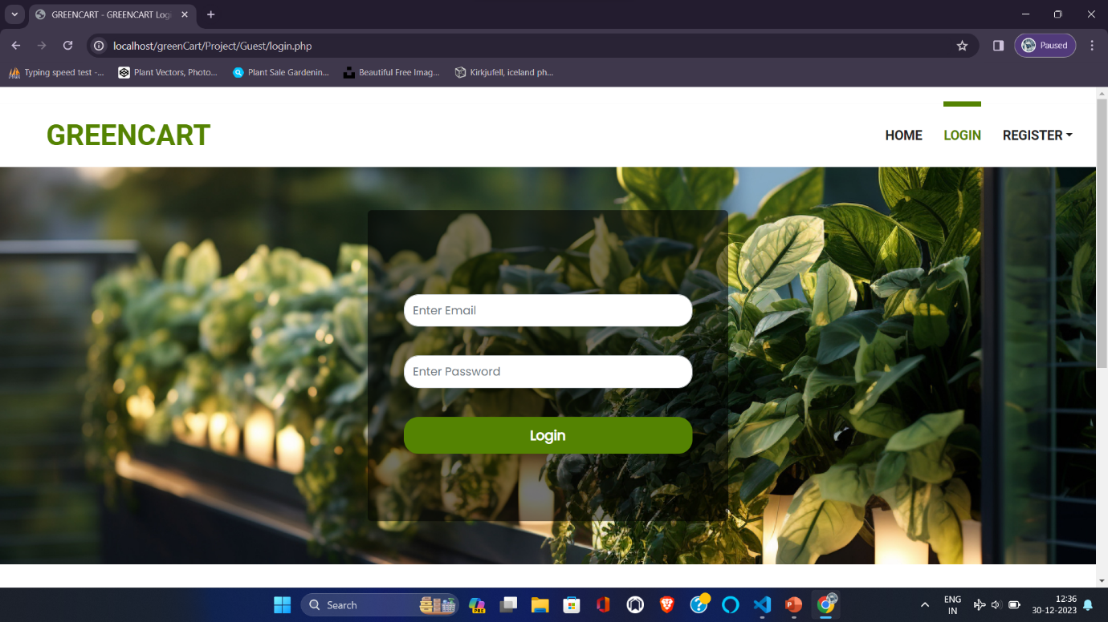
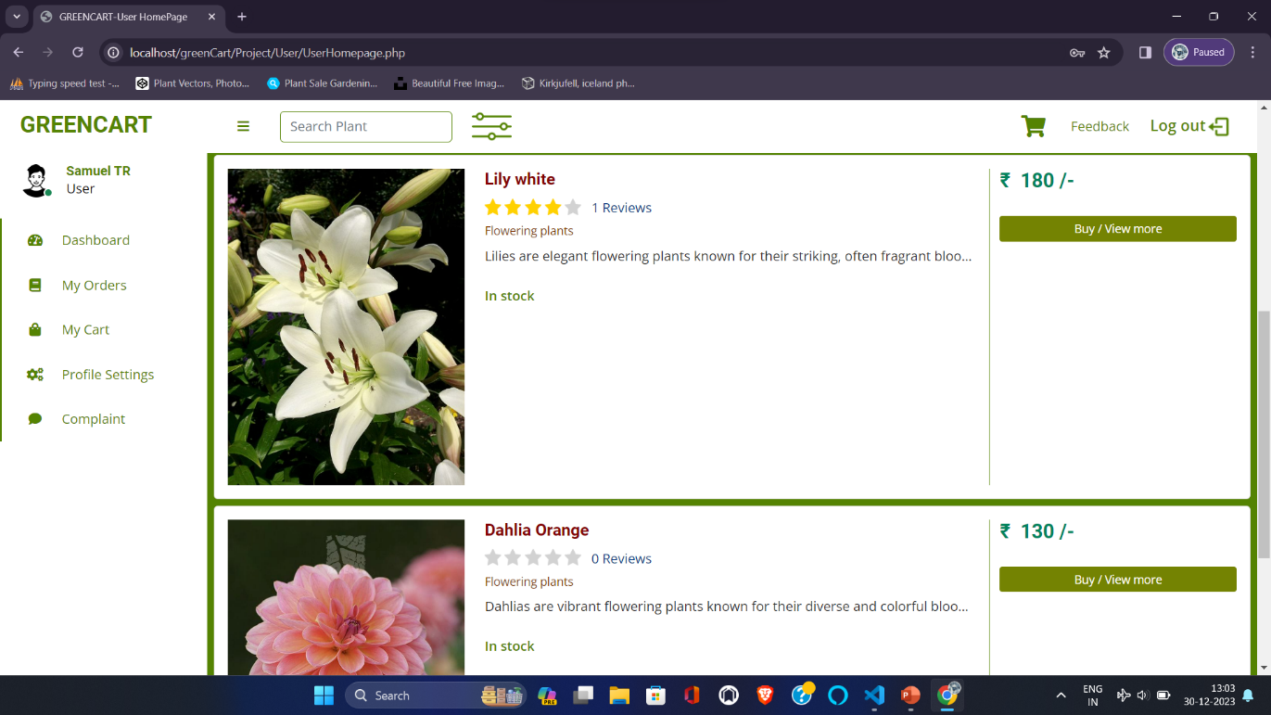
GREENCART
- 69 -
14.APPENDIX
14.1 SCREEN SHOTS
LOGIN FORM
USER DASHBOARD

Slide 76
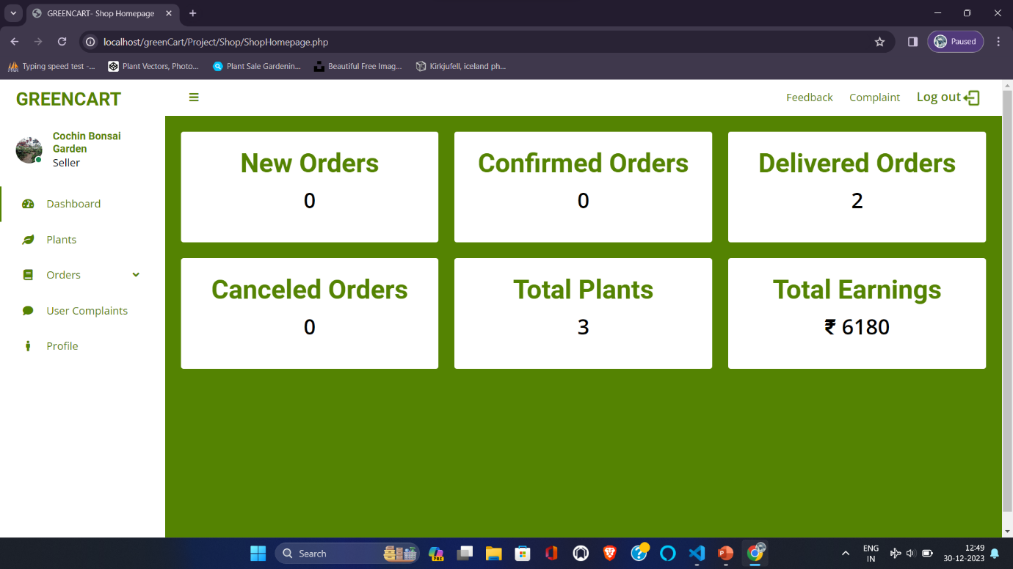
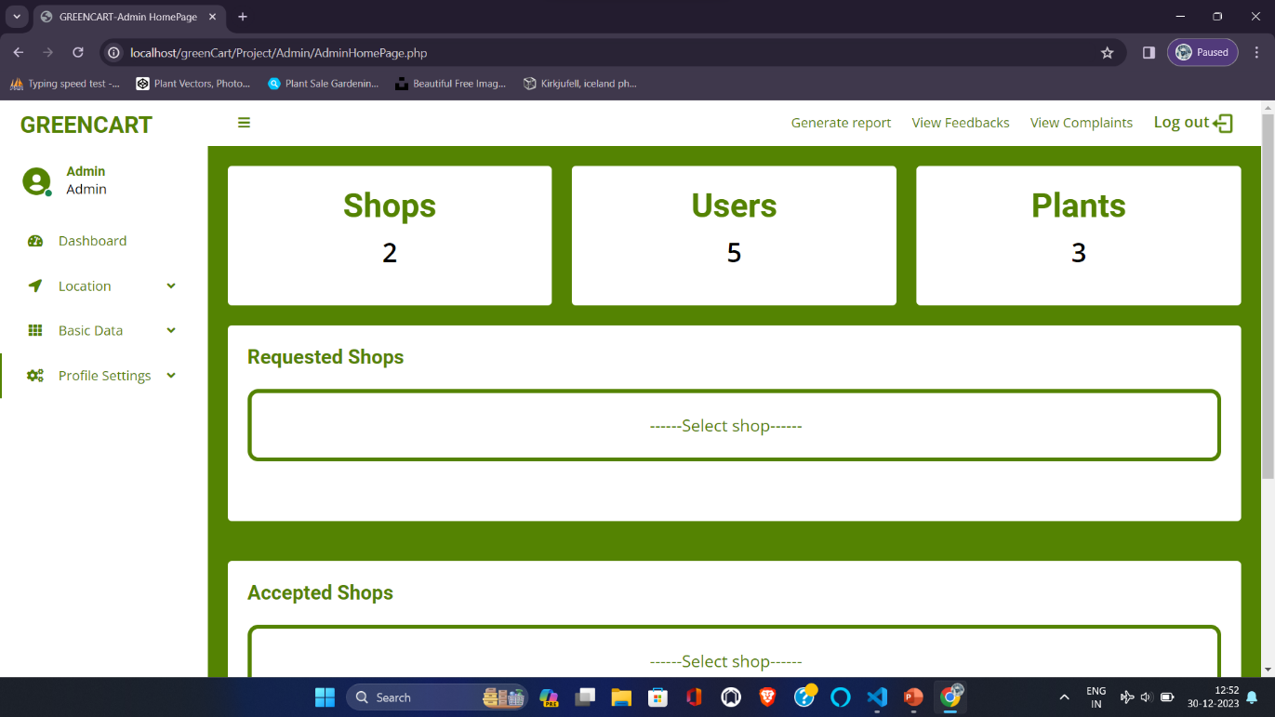
GREENCART
- 70 -
SHOP DASHBOARD
ADMIN DASHBOARD

Slide 77
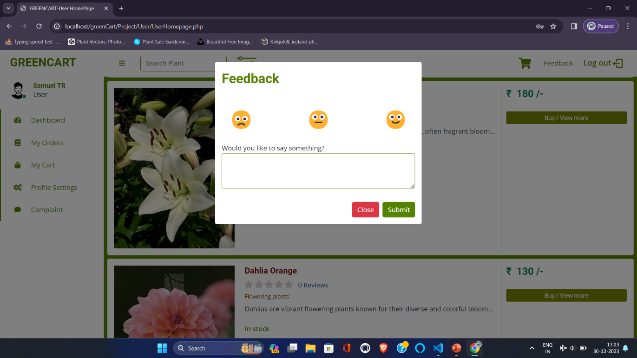
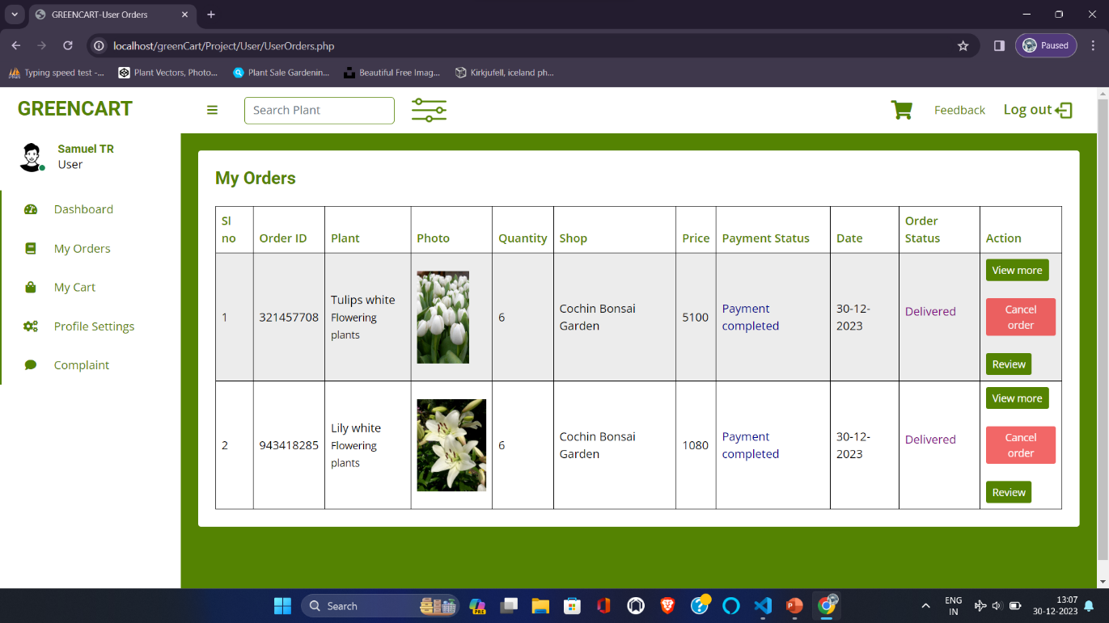
GREENCART
- 71 -
FORM FOR SENDING FEEDBACKS
USER ORDERS

Slide 78
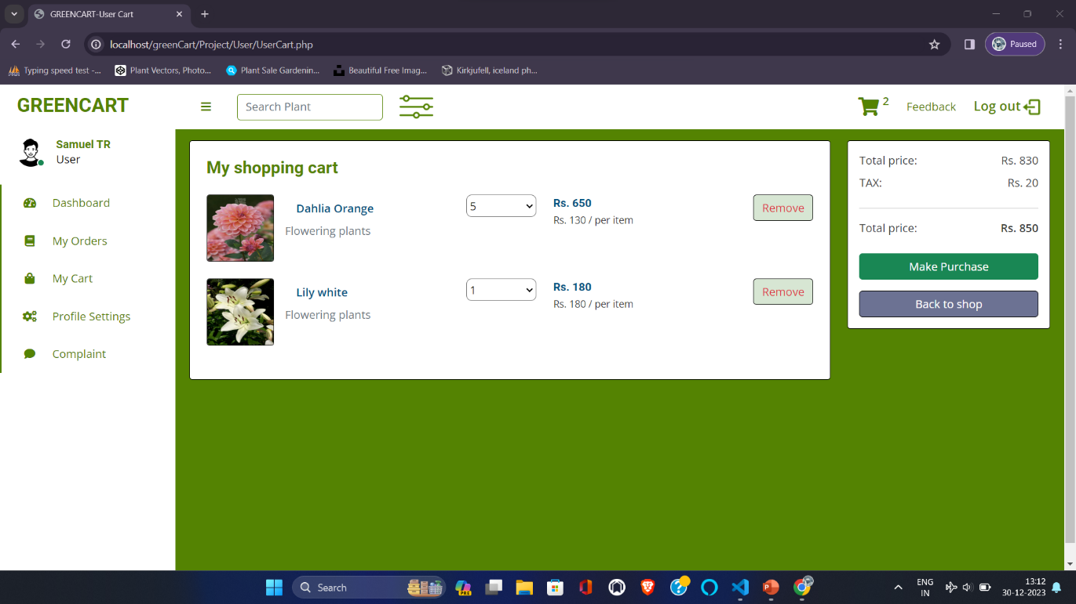
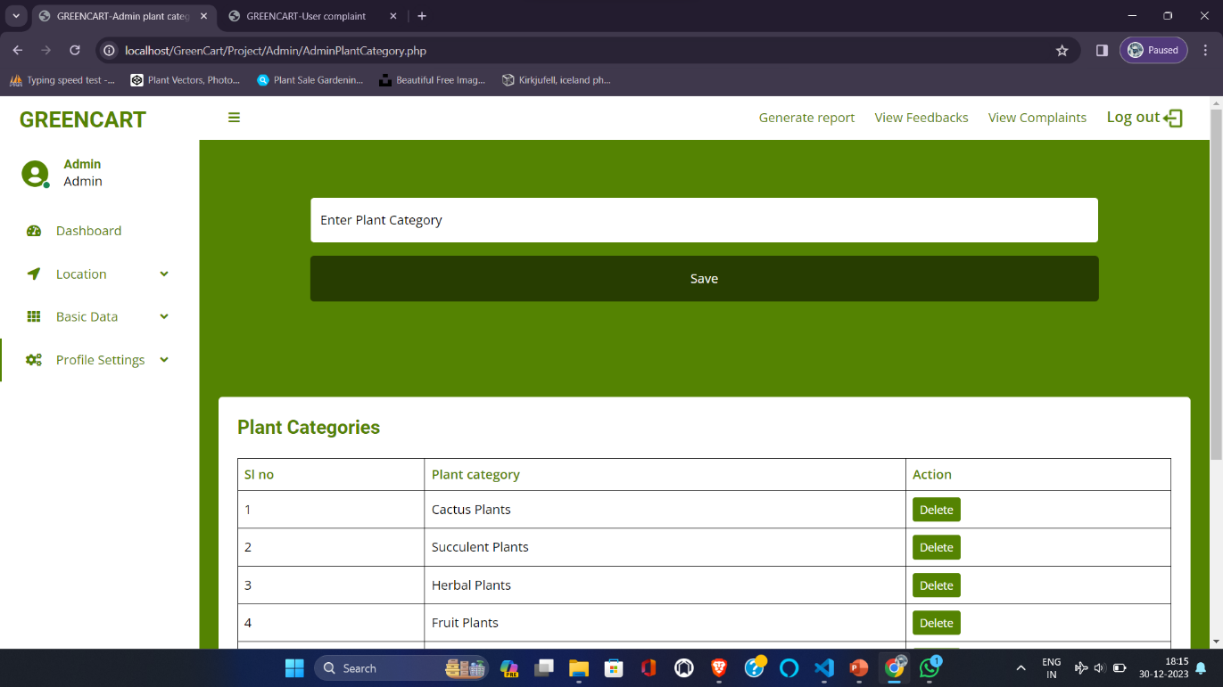
GREENCART
- 72 -
SHOPPING CART
FORM FOR ADDING PLANT CATEGORIES

Slide 79
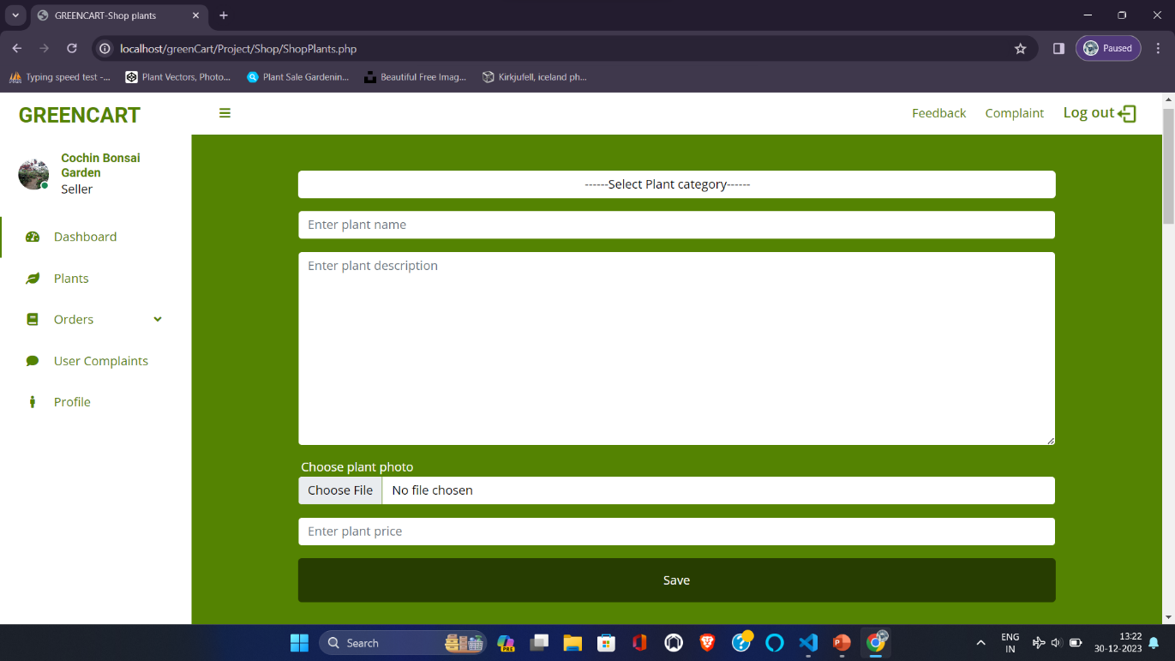
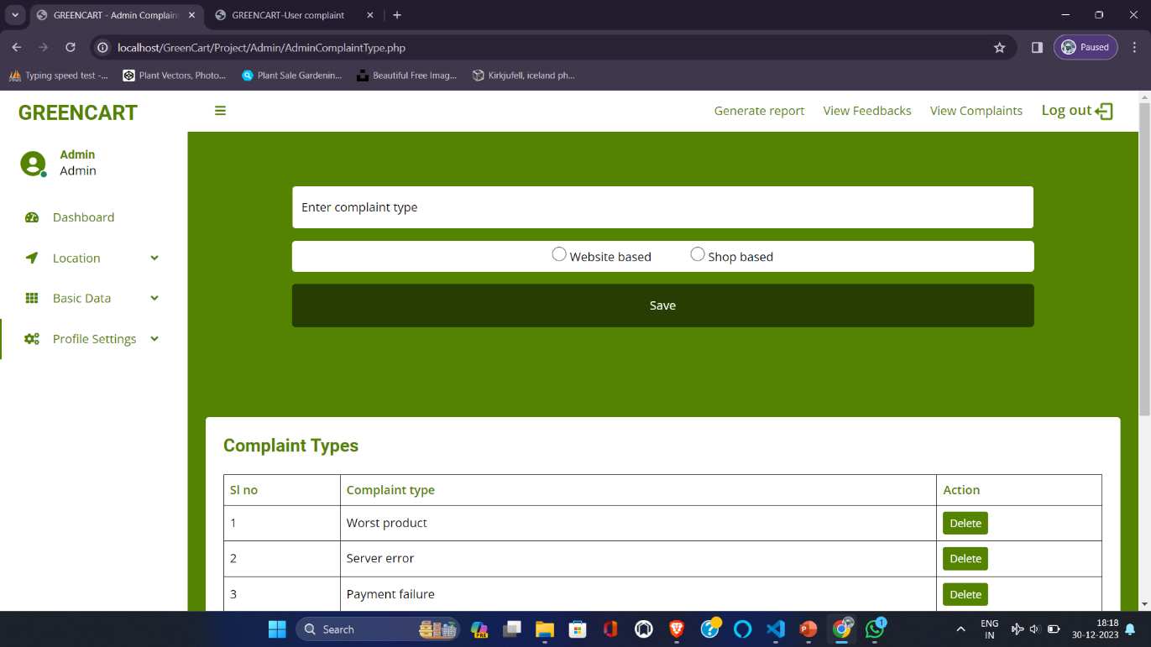
GREENCART
- 73 -
FORM FOR ADDING PLANTS
FORM FOR ADDING COMPLAINT TYPES

Slide 80
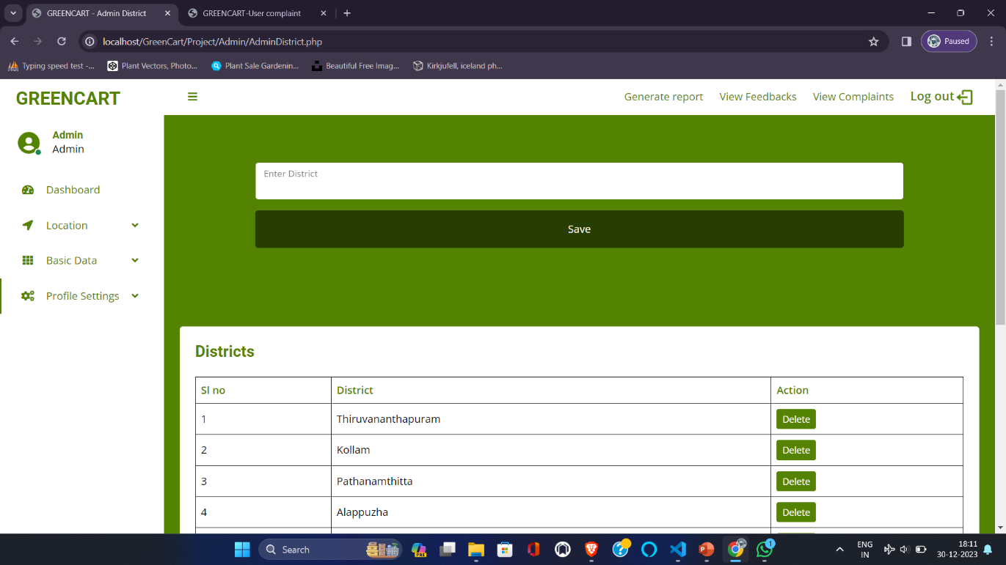
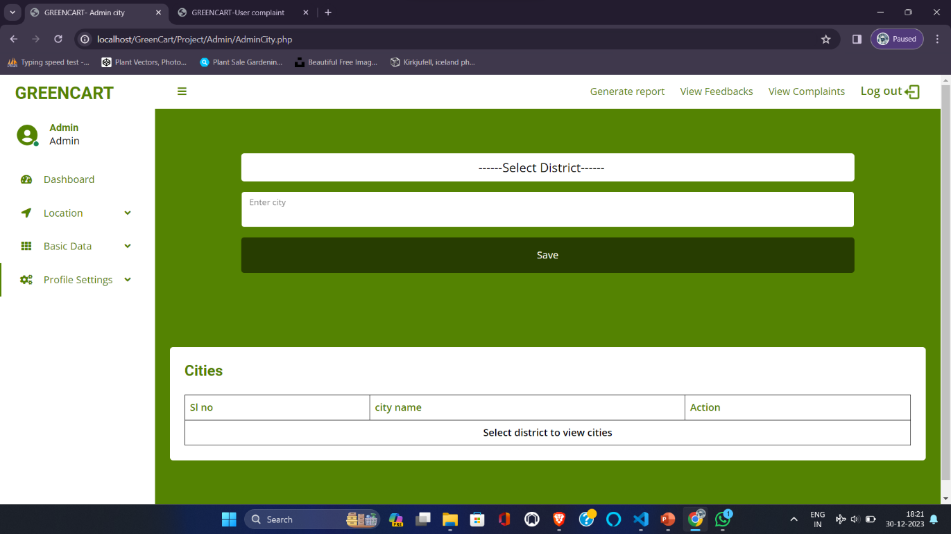
GREENCART
- 74 -
FORM FOR ADDING DISTRICTS
FORM FOR ADDING AND VIEW CITIES

Slide 81
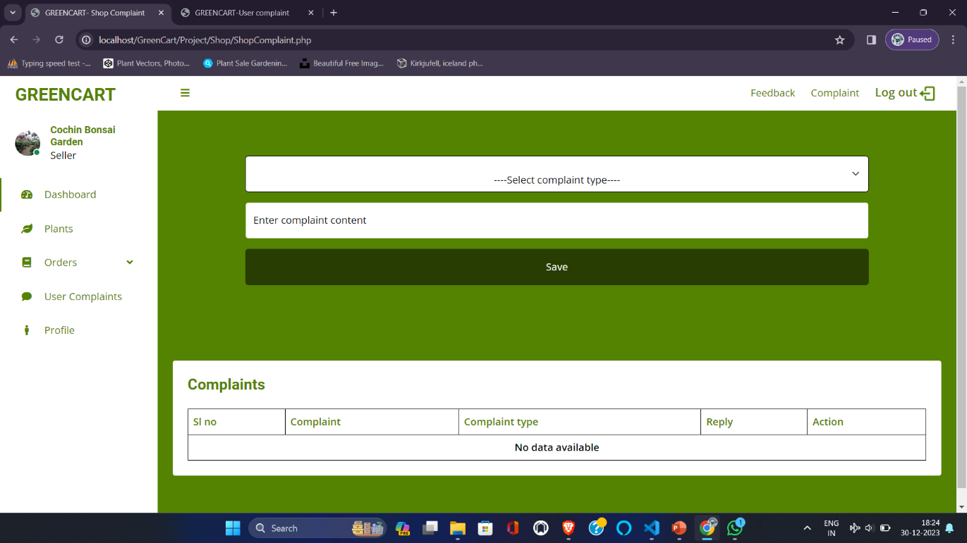
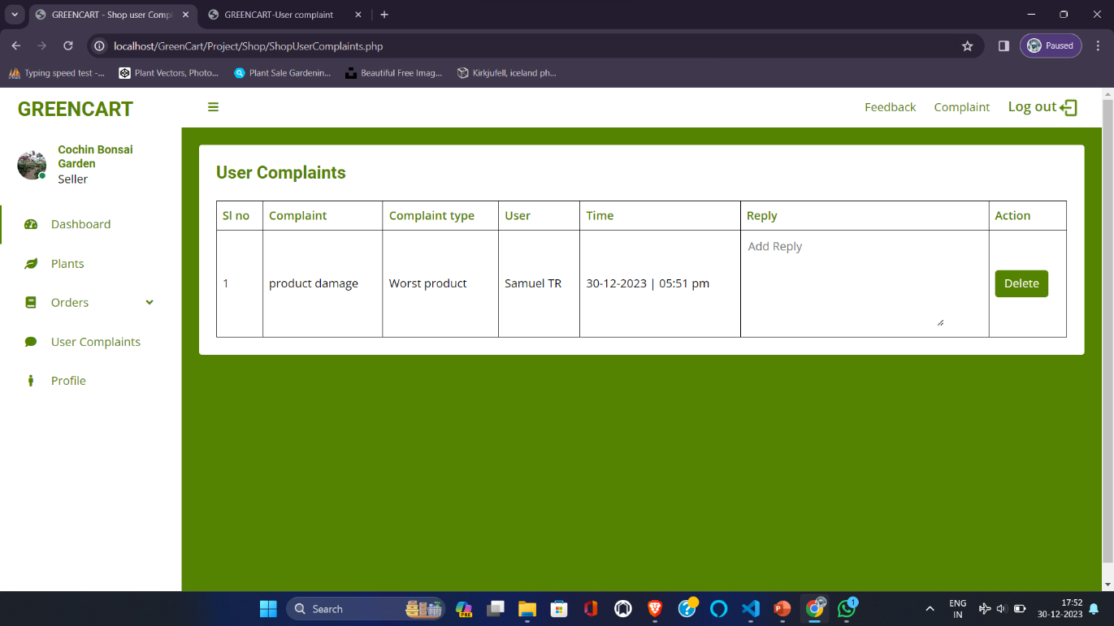
GREENCART
- 75 -
FORM FOR SENDING COMPLAINTS TO THE ADMIN (WEBSITE BASED)
FORM FOR SENDING REPLY FOR USER COMPLAINTS (PRODUCT BASED)

Slide 82
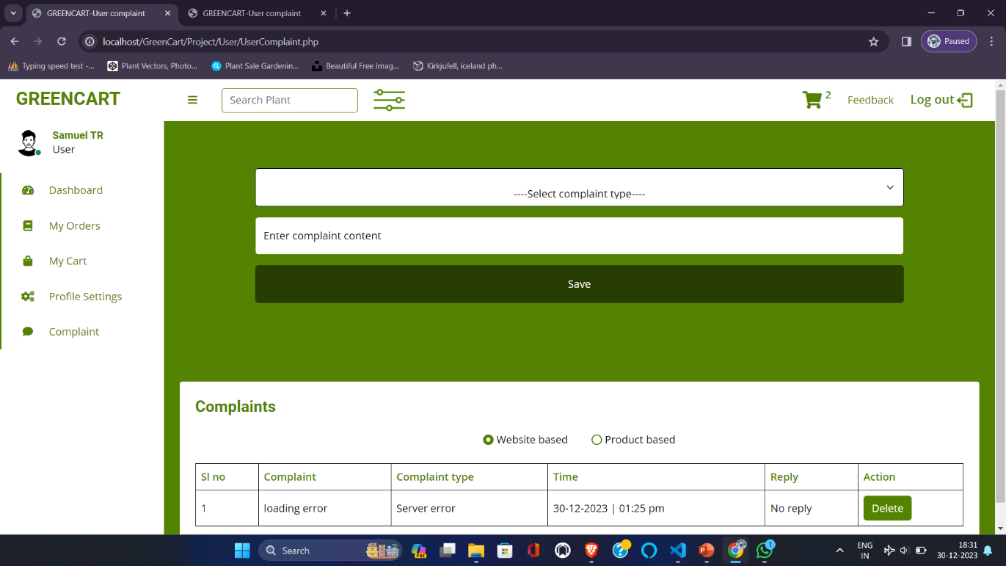
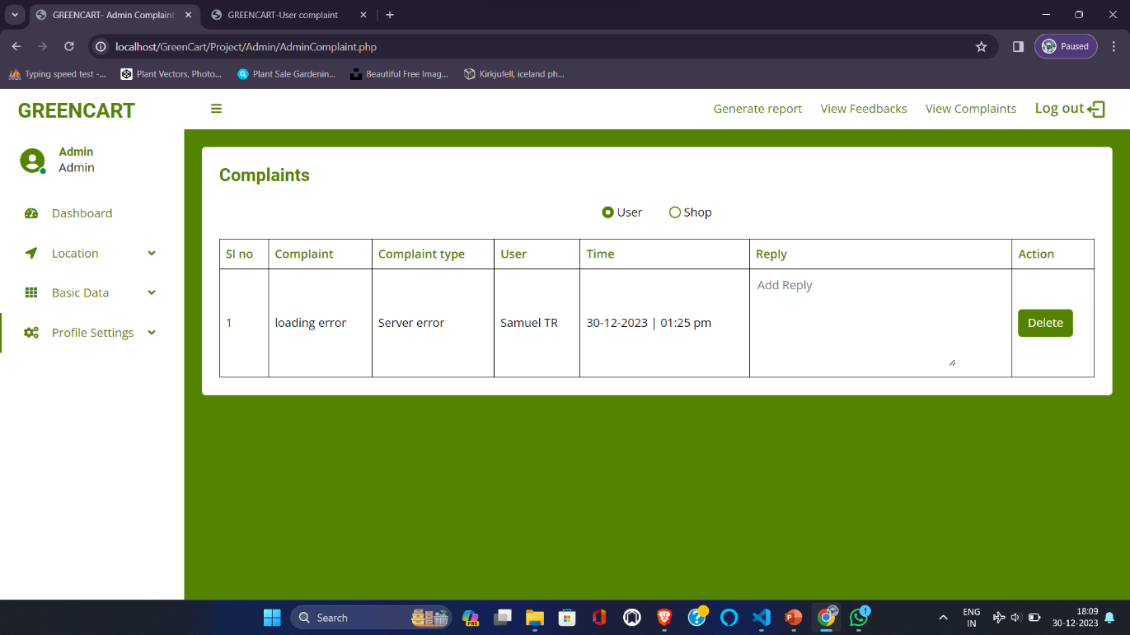
GREENCART
- 76 -
FORM FOR SENDING COMPLAINTS TO THE SHOP OR ADMIN
FORM FOR SENDING REPLY TO USER COMPLAINTS OR SHOP COMPLAINTS

